Slide 1

AIRBNB DATA ANALYSIS USING HIVE
CIS 5200| TERM Project Group 3,By:
SAMYUKTHA MURALIDHARAN
SanJANA BODDIREDDY
Shilpa Konde Deshmukh
VERUSCA AIMIE CAPUNO
Guided By:
Prof Jongwook Woo

Slide 2






INTRODUCTION
Lesser price than a hotel room and more amenities
Better hosts and more bookings increases the value of Airbnb
Connects travelers with property renters
Help their hosts succeed
Factors to be considered when buying a rental home

Slide 3

GOALS
Determining the number of Airbnb listings worldwide and in the various States of USA
Seasonality in demand for listings and property types in New York City and LA County over years.
Distribution and the number of listings in NYC and LA County.
Revenue of various neighborhoods.
Determining the average price of listings and of various property types of each neighborhood in NYC.
Supply and Demand for various bedroom/accommodation configurations in LA County
Analyzing what it takes to become a Super host.
This Photo by Unknown Author is licensed under CC BY-SA

Slide 4

DATASET URLs
Airbnb Ratings, Listings and Reviews
https://www.kaggle.com/samyukthamurali/airbnb-ratings-dataset
Dataset Source URL:
https://public.opendatasoft.com/explore/dataset/airbnb-ratings/table/?disjunctive.city&disjunctive.neighbourhood_cleansed&sort=number_of_reviews
http://insideairbnb.com/get-the-data.html
https://public.opendatasoft.com/explore/dataset/airbnb-reviews/table/
Total Size: 3 GB

Slide 5






TECHNICAL SPECIFICATONS
Cluster version: Hadoop 2.7.1.2.4.2.0-258
Cluster number of nodes: 3
CPU speed: 2.20 GHz
HDFS Capacity: 1003.6 GB
Memory: 241.821 GB
Hive Version: Apache Hive 1.2.1000.2.4.2.0-258

Slide 6






FLOWCHART
Dataset source
Visualize
Transfer files to Oracle BDCE
Store data
Query the data
Download files

Slide 7


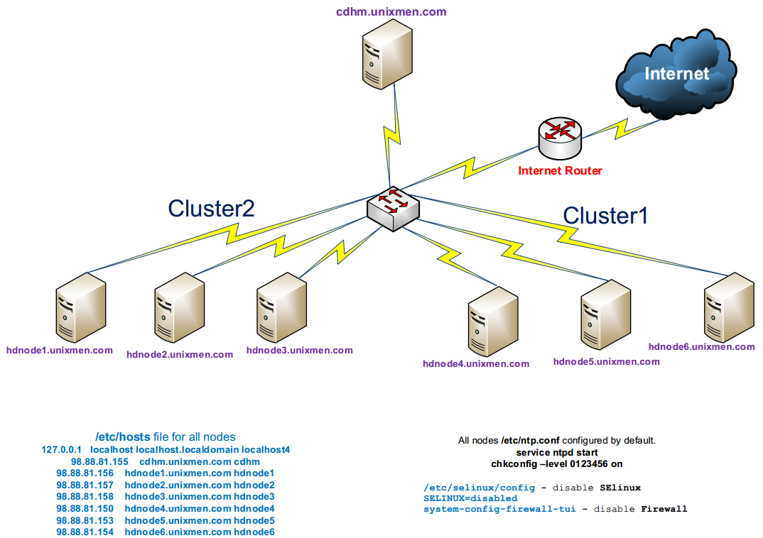

ARCHITECHTURE
wget links
ssh smurali2@129.150.71.75

Slide 8
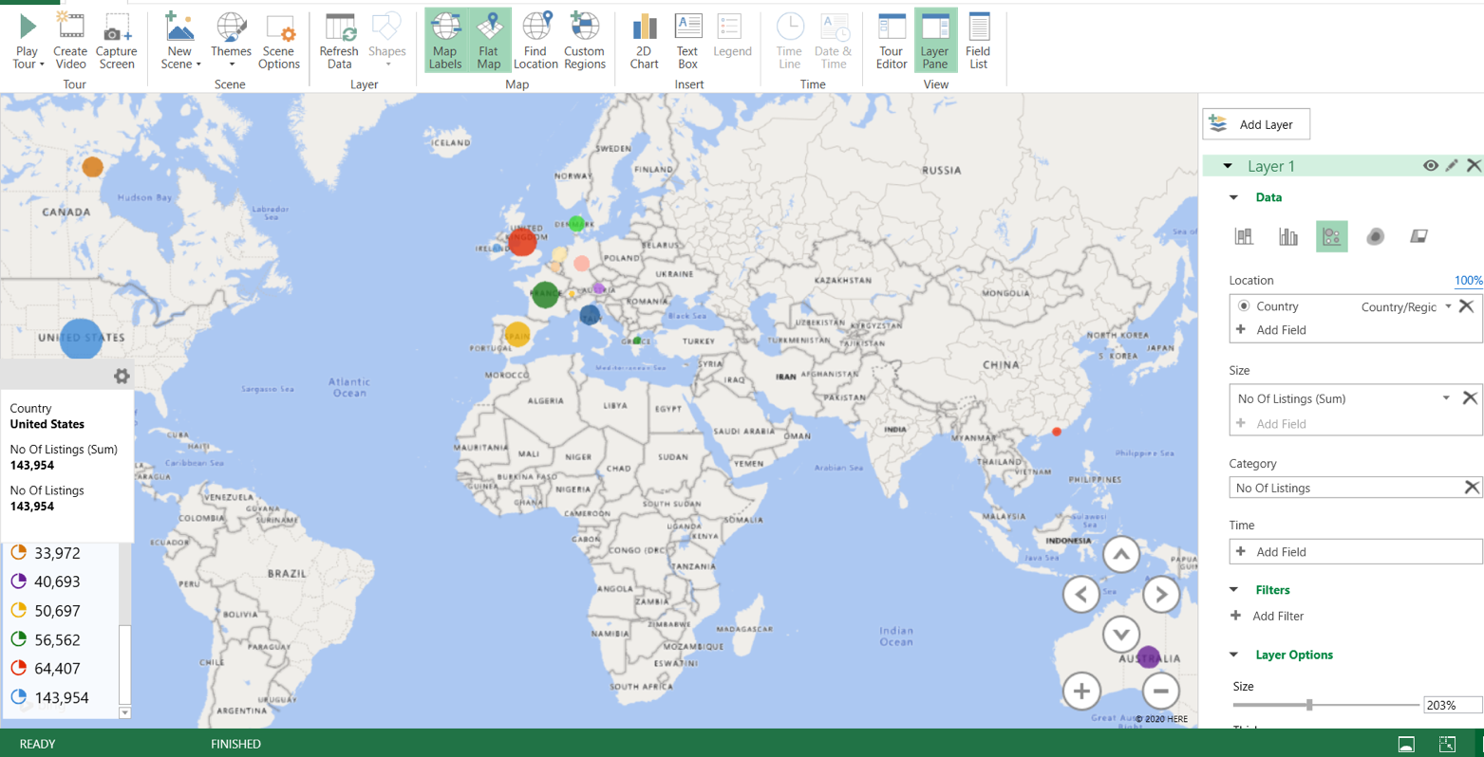
Listings Worldwide
Maximum Listings
United States: 143,954
United Kingdom:
64,407

Slide 9
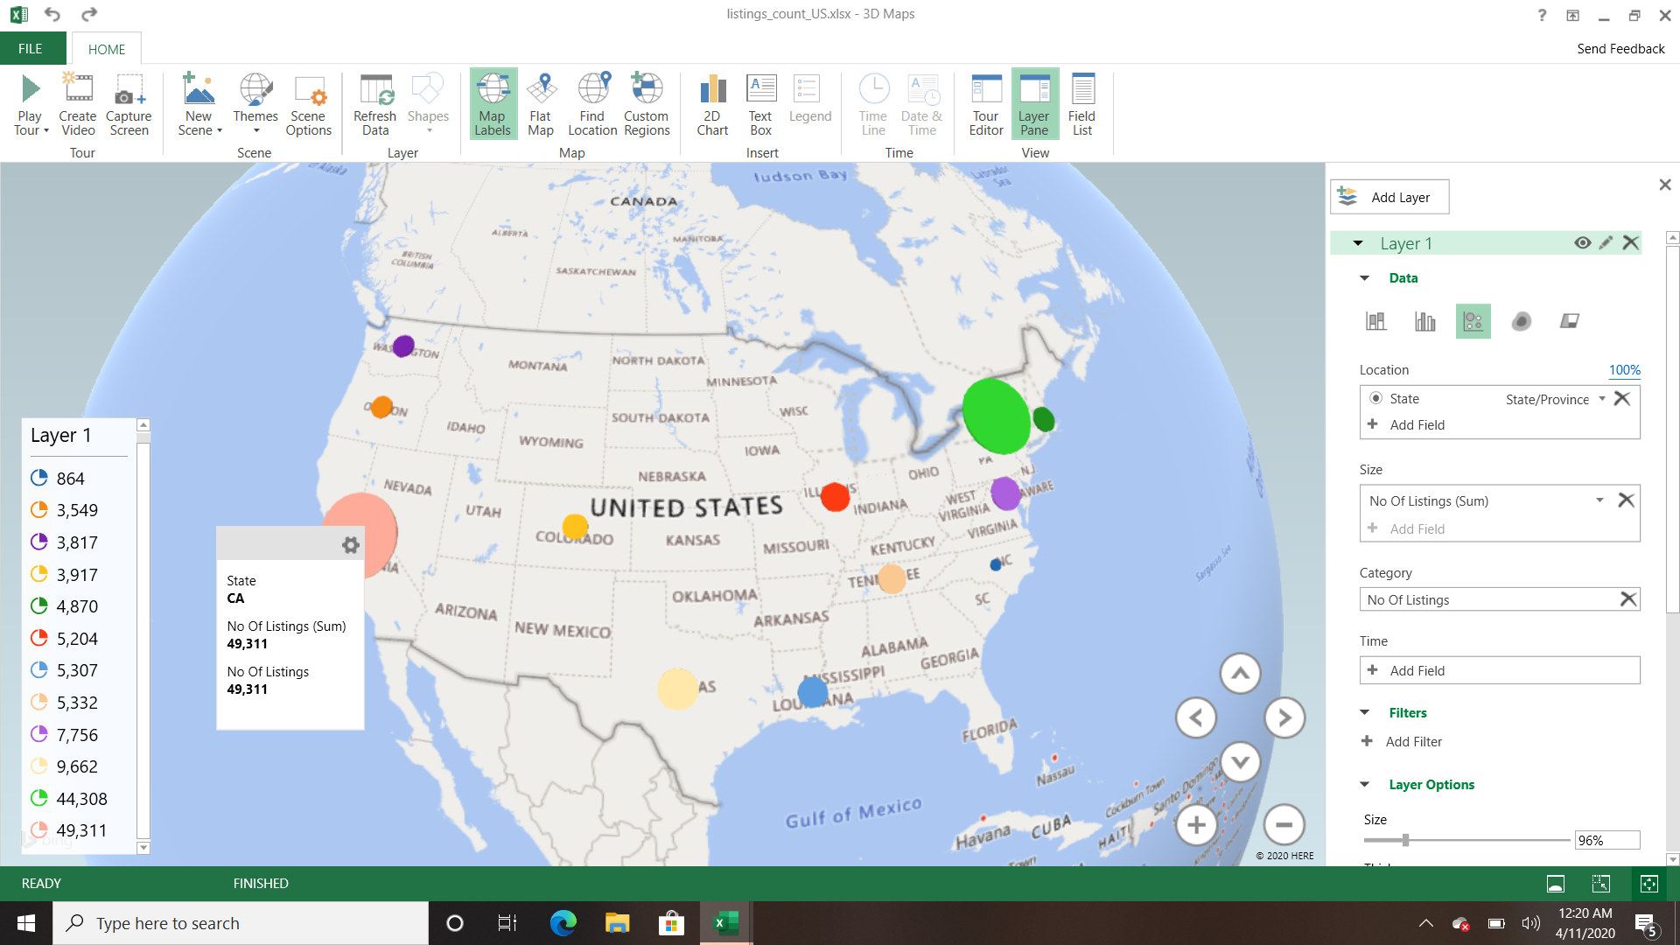
Listings In Various US States
Maximum Listings:
California:49,311
New York:44,308

Slide 10
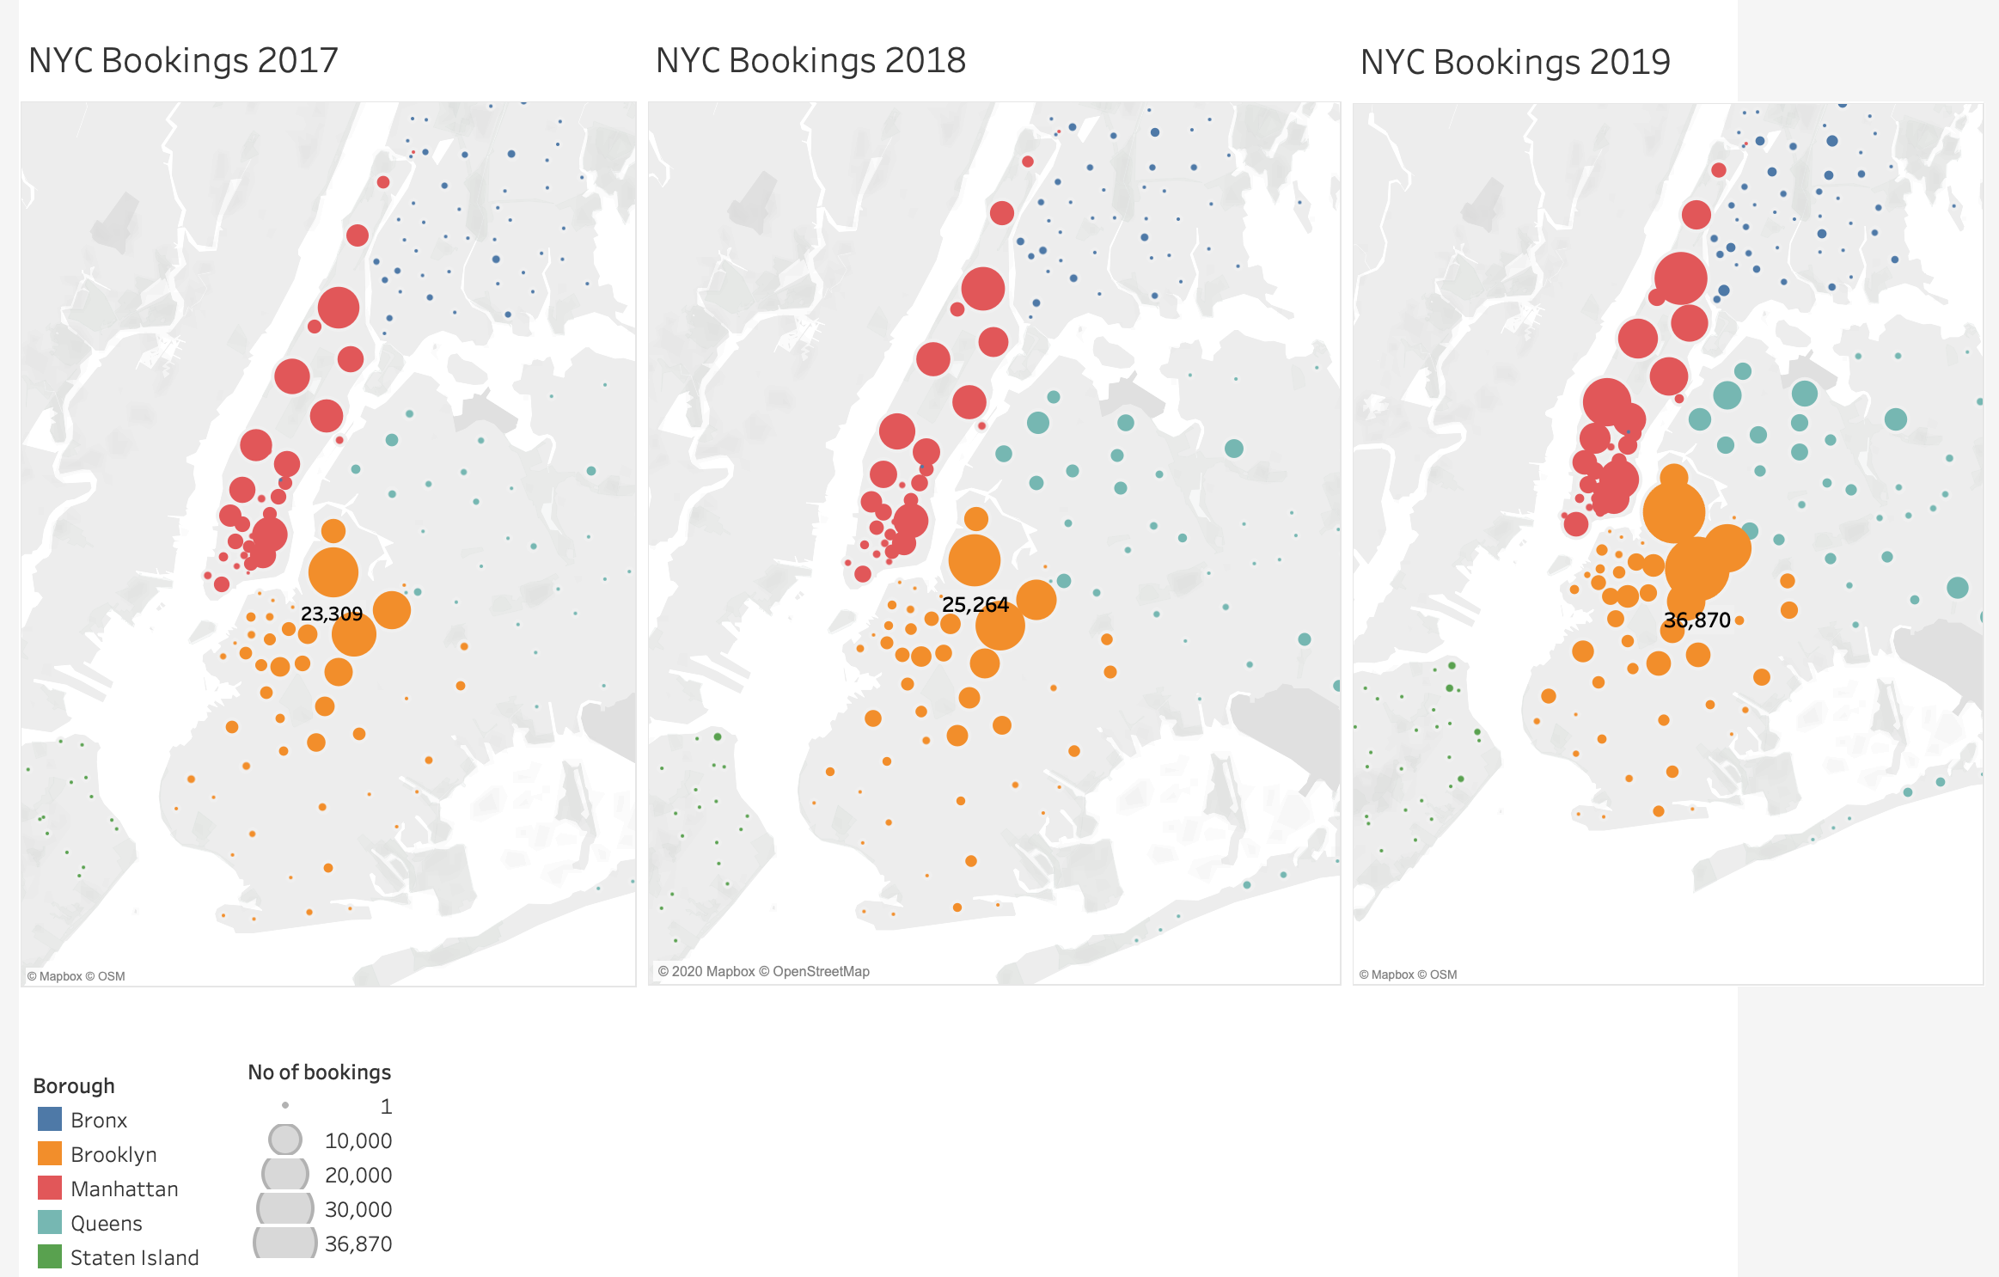
NYC Seasonality In Demand
Animation link: https://drive.google.com/open?id=1RnCDN_1Th4bZaHYwLL6KRy0grJtpZcW8

Slide 11
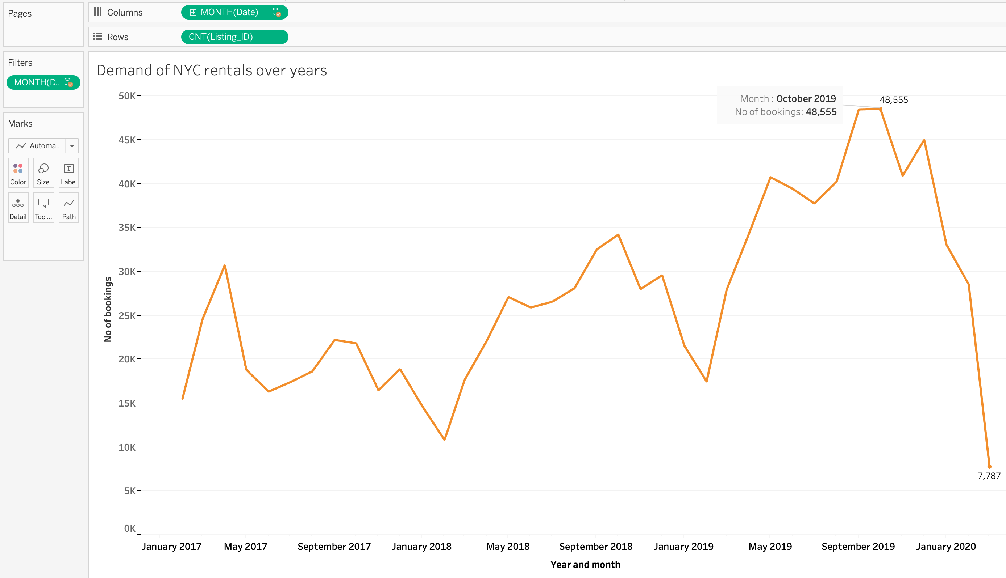
NYC bookings over years
Bookings Of NYC Properties Over Years
Gradually increasing from 2017 and bookings are maximum in 2019

Slide 12
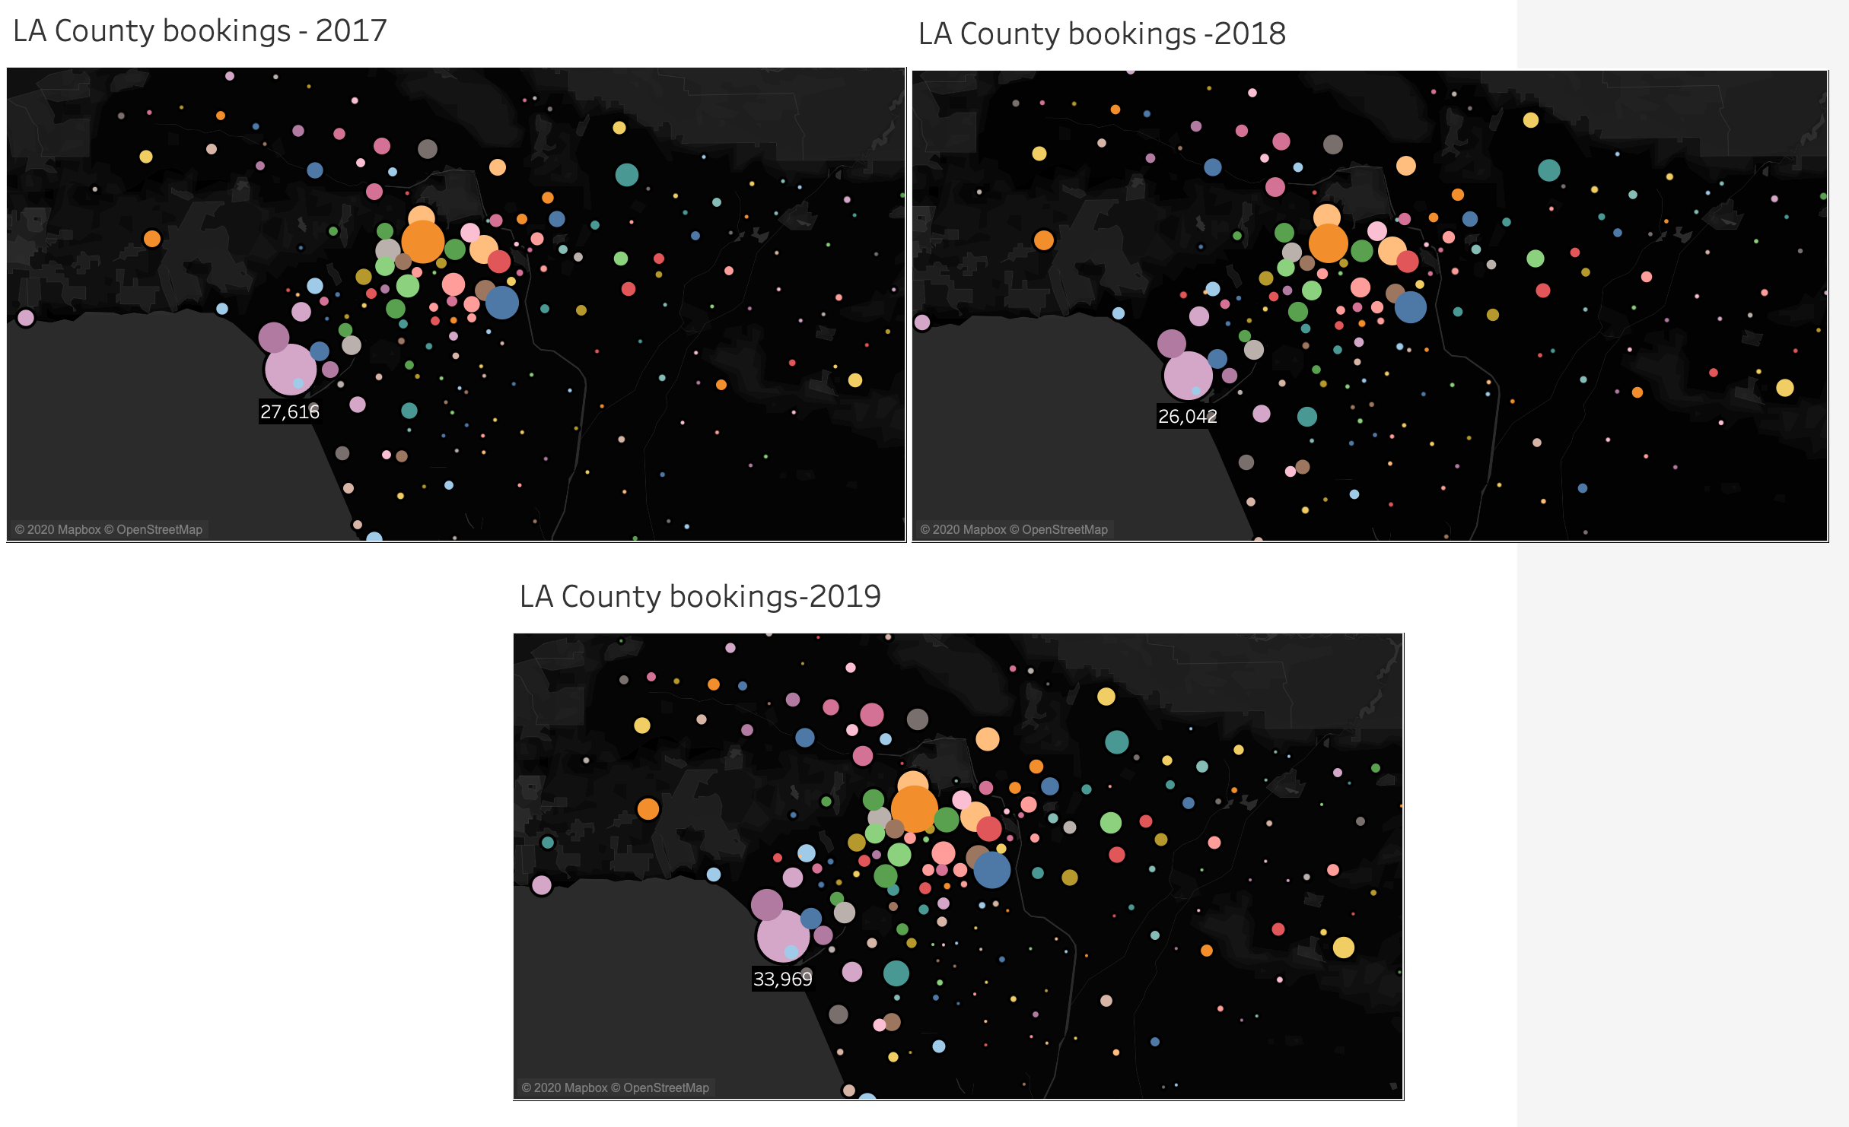
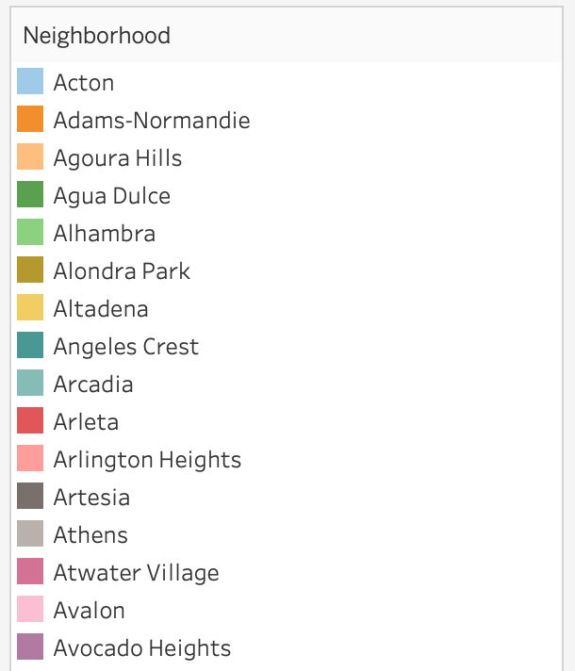
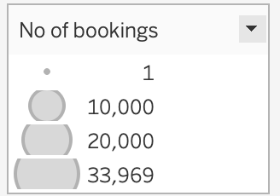
LA County Seasonality In Demand
Animation link:
https://drive.google.com/open?id=1fYHQPU-ofW9cfv0slyhra17tA5MbMSMH

Slide 13
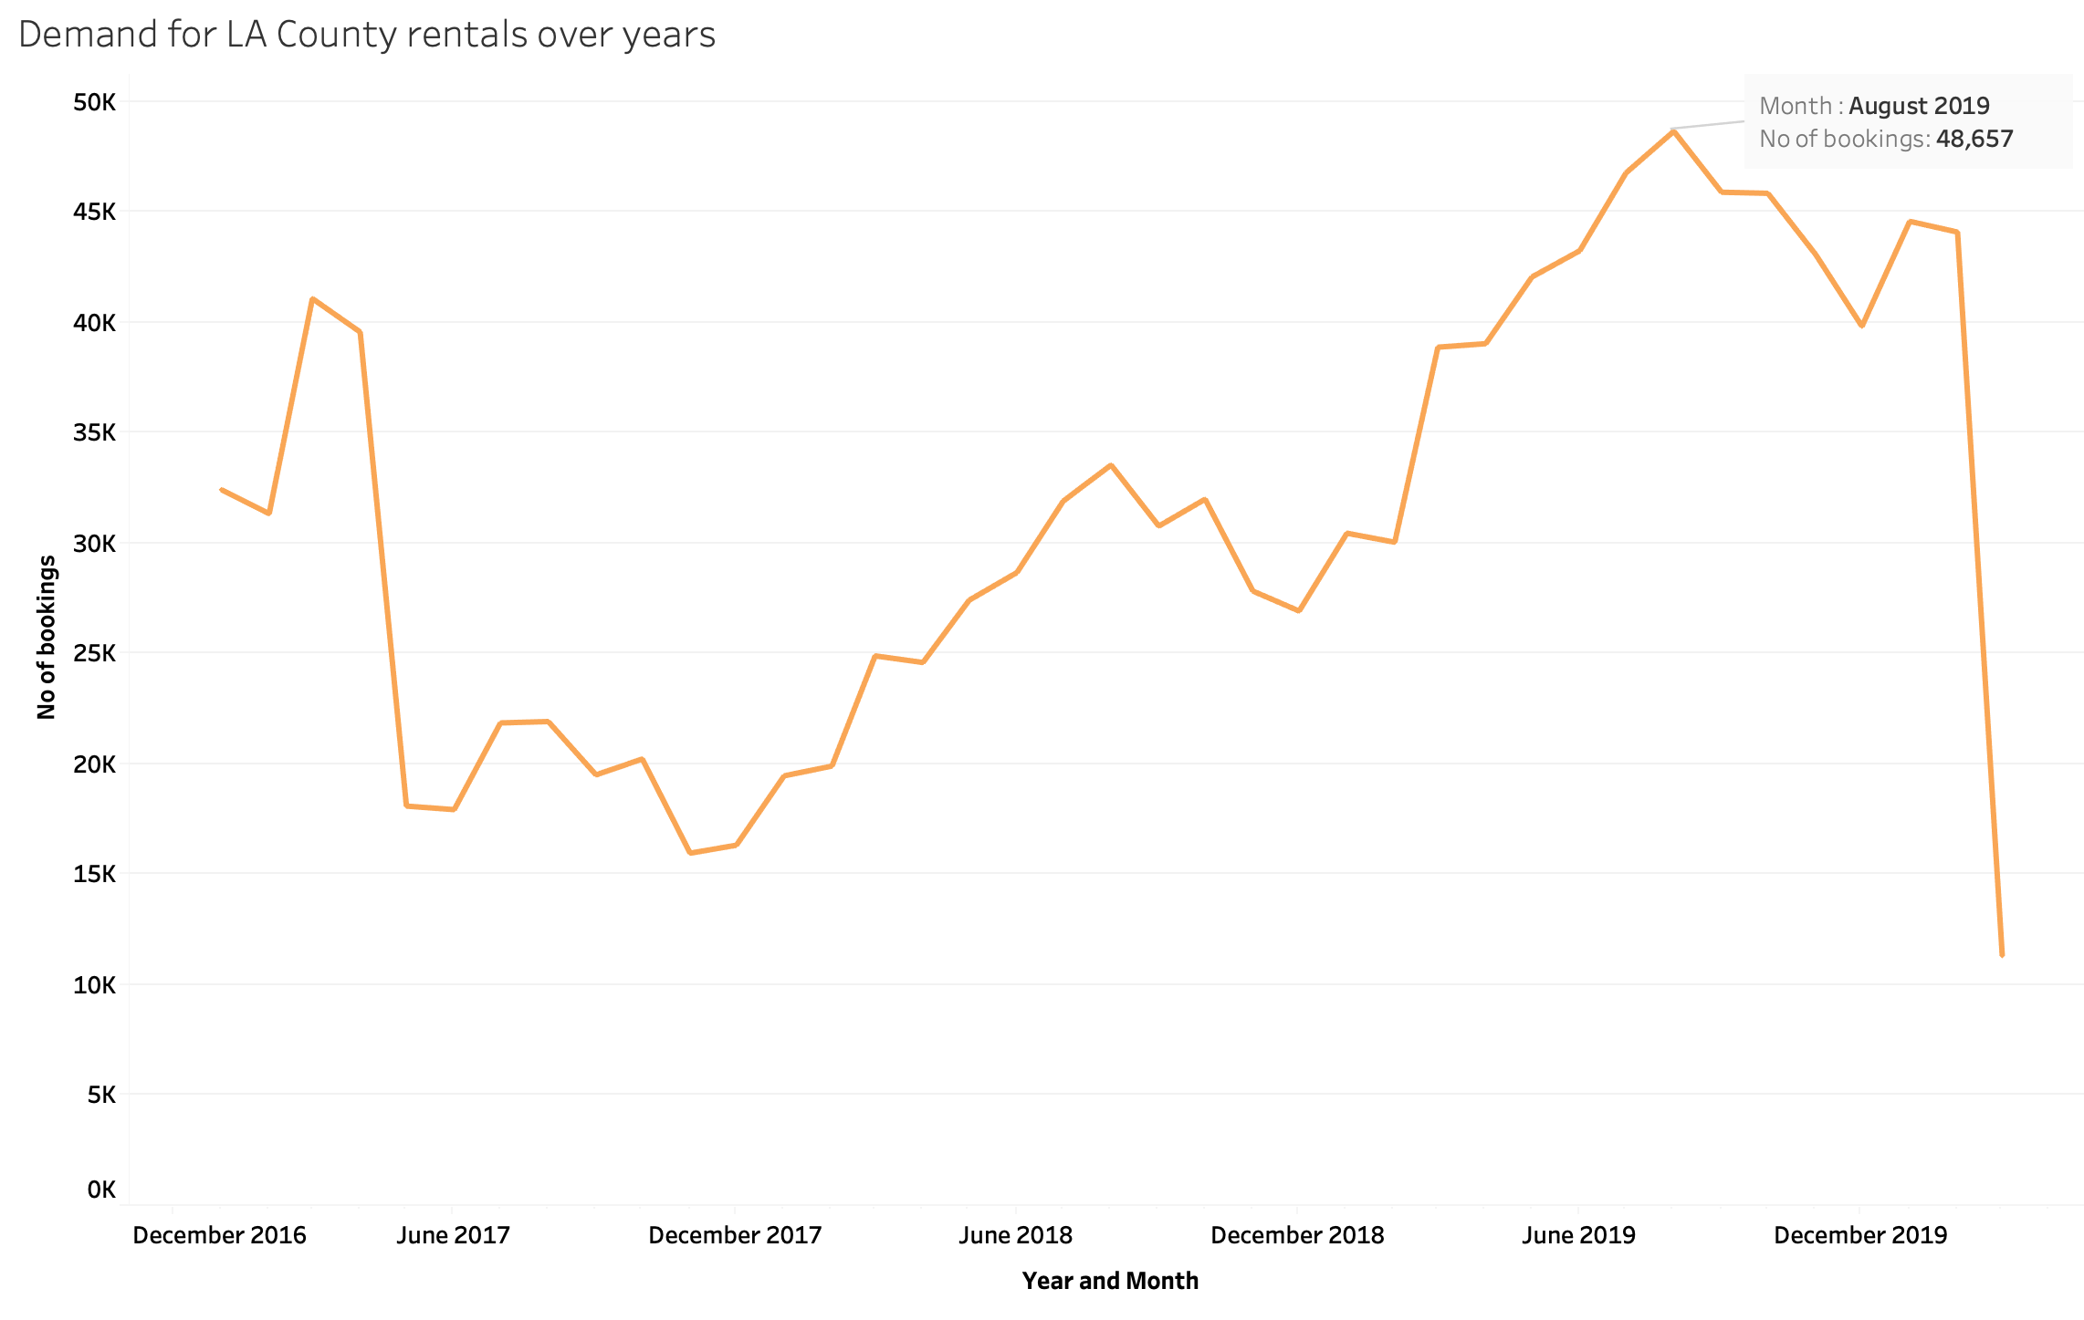
LA County Bookings Over Years
Bookings are more in the first 6 months of 2017 and highest in August and September months of 2019

Slide 14
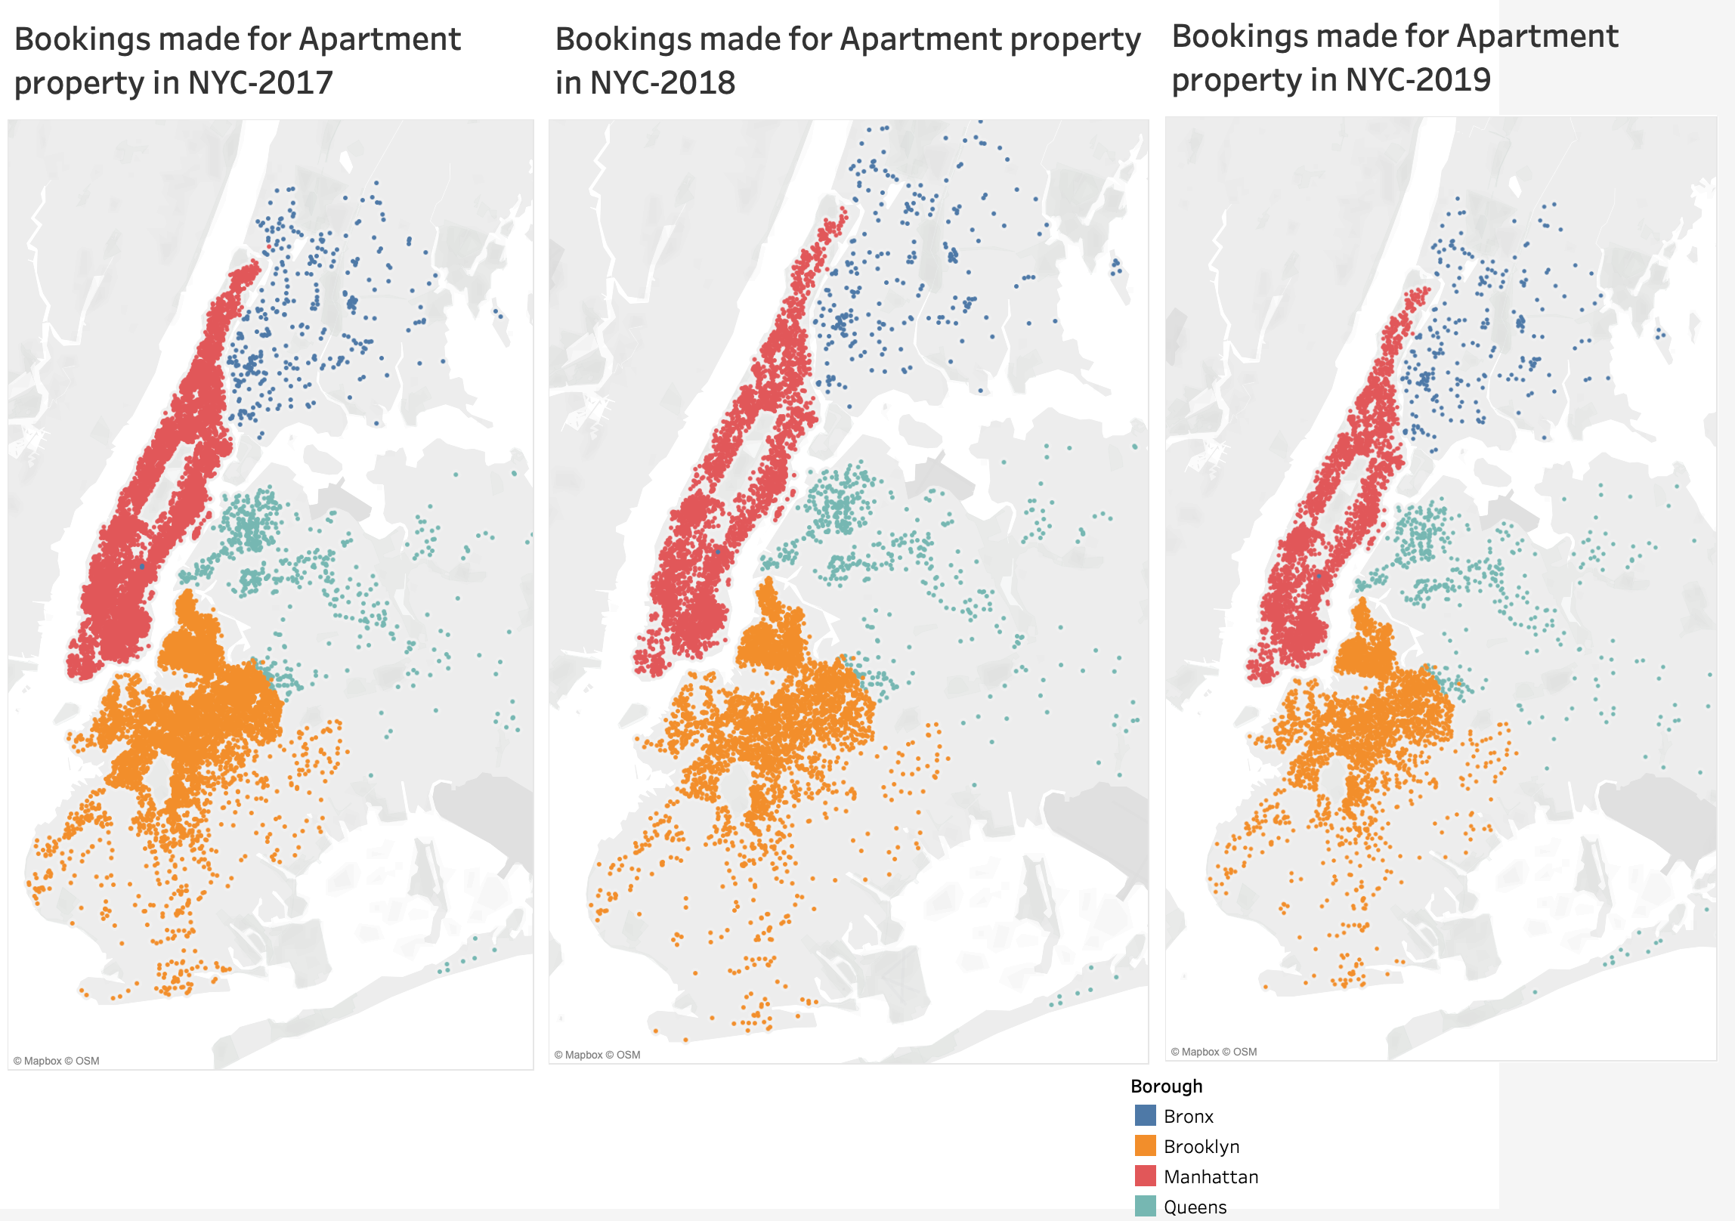
Demand For Apartments In NYC
Animation Link:
https://drive.google.com/open?id=1D3hlrDOvhyDcu4KLB0emLMc0sAxZuoBW

Slide 15
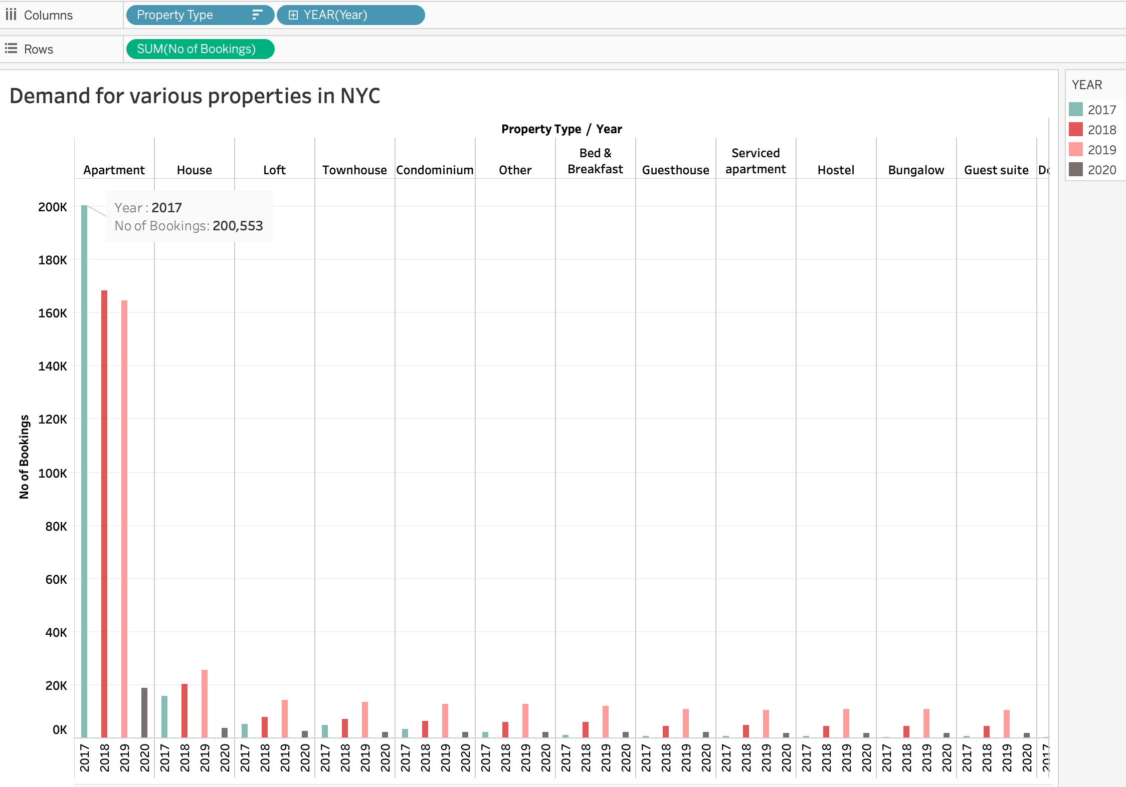
Demand for various property types in NYC
Demand For Various Property Types In NYC
Apartment has the maximum number of bookings in the year 2017

Slide 16
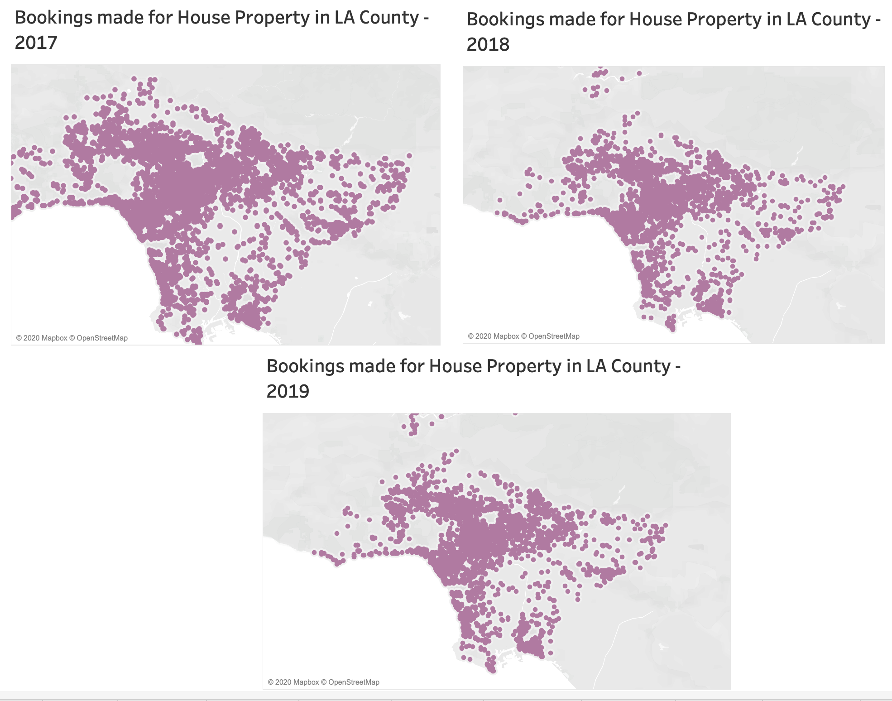
Demand For House Property In LA
Animation Link:
https://drive.google.com/open?id=1ZCUwqSegVzsfpflRn_3DuyCa3tYKSgx3

Slide 17
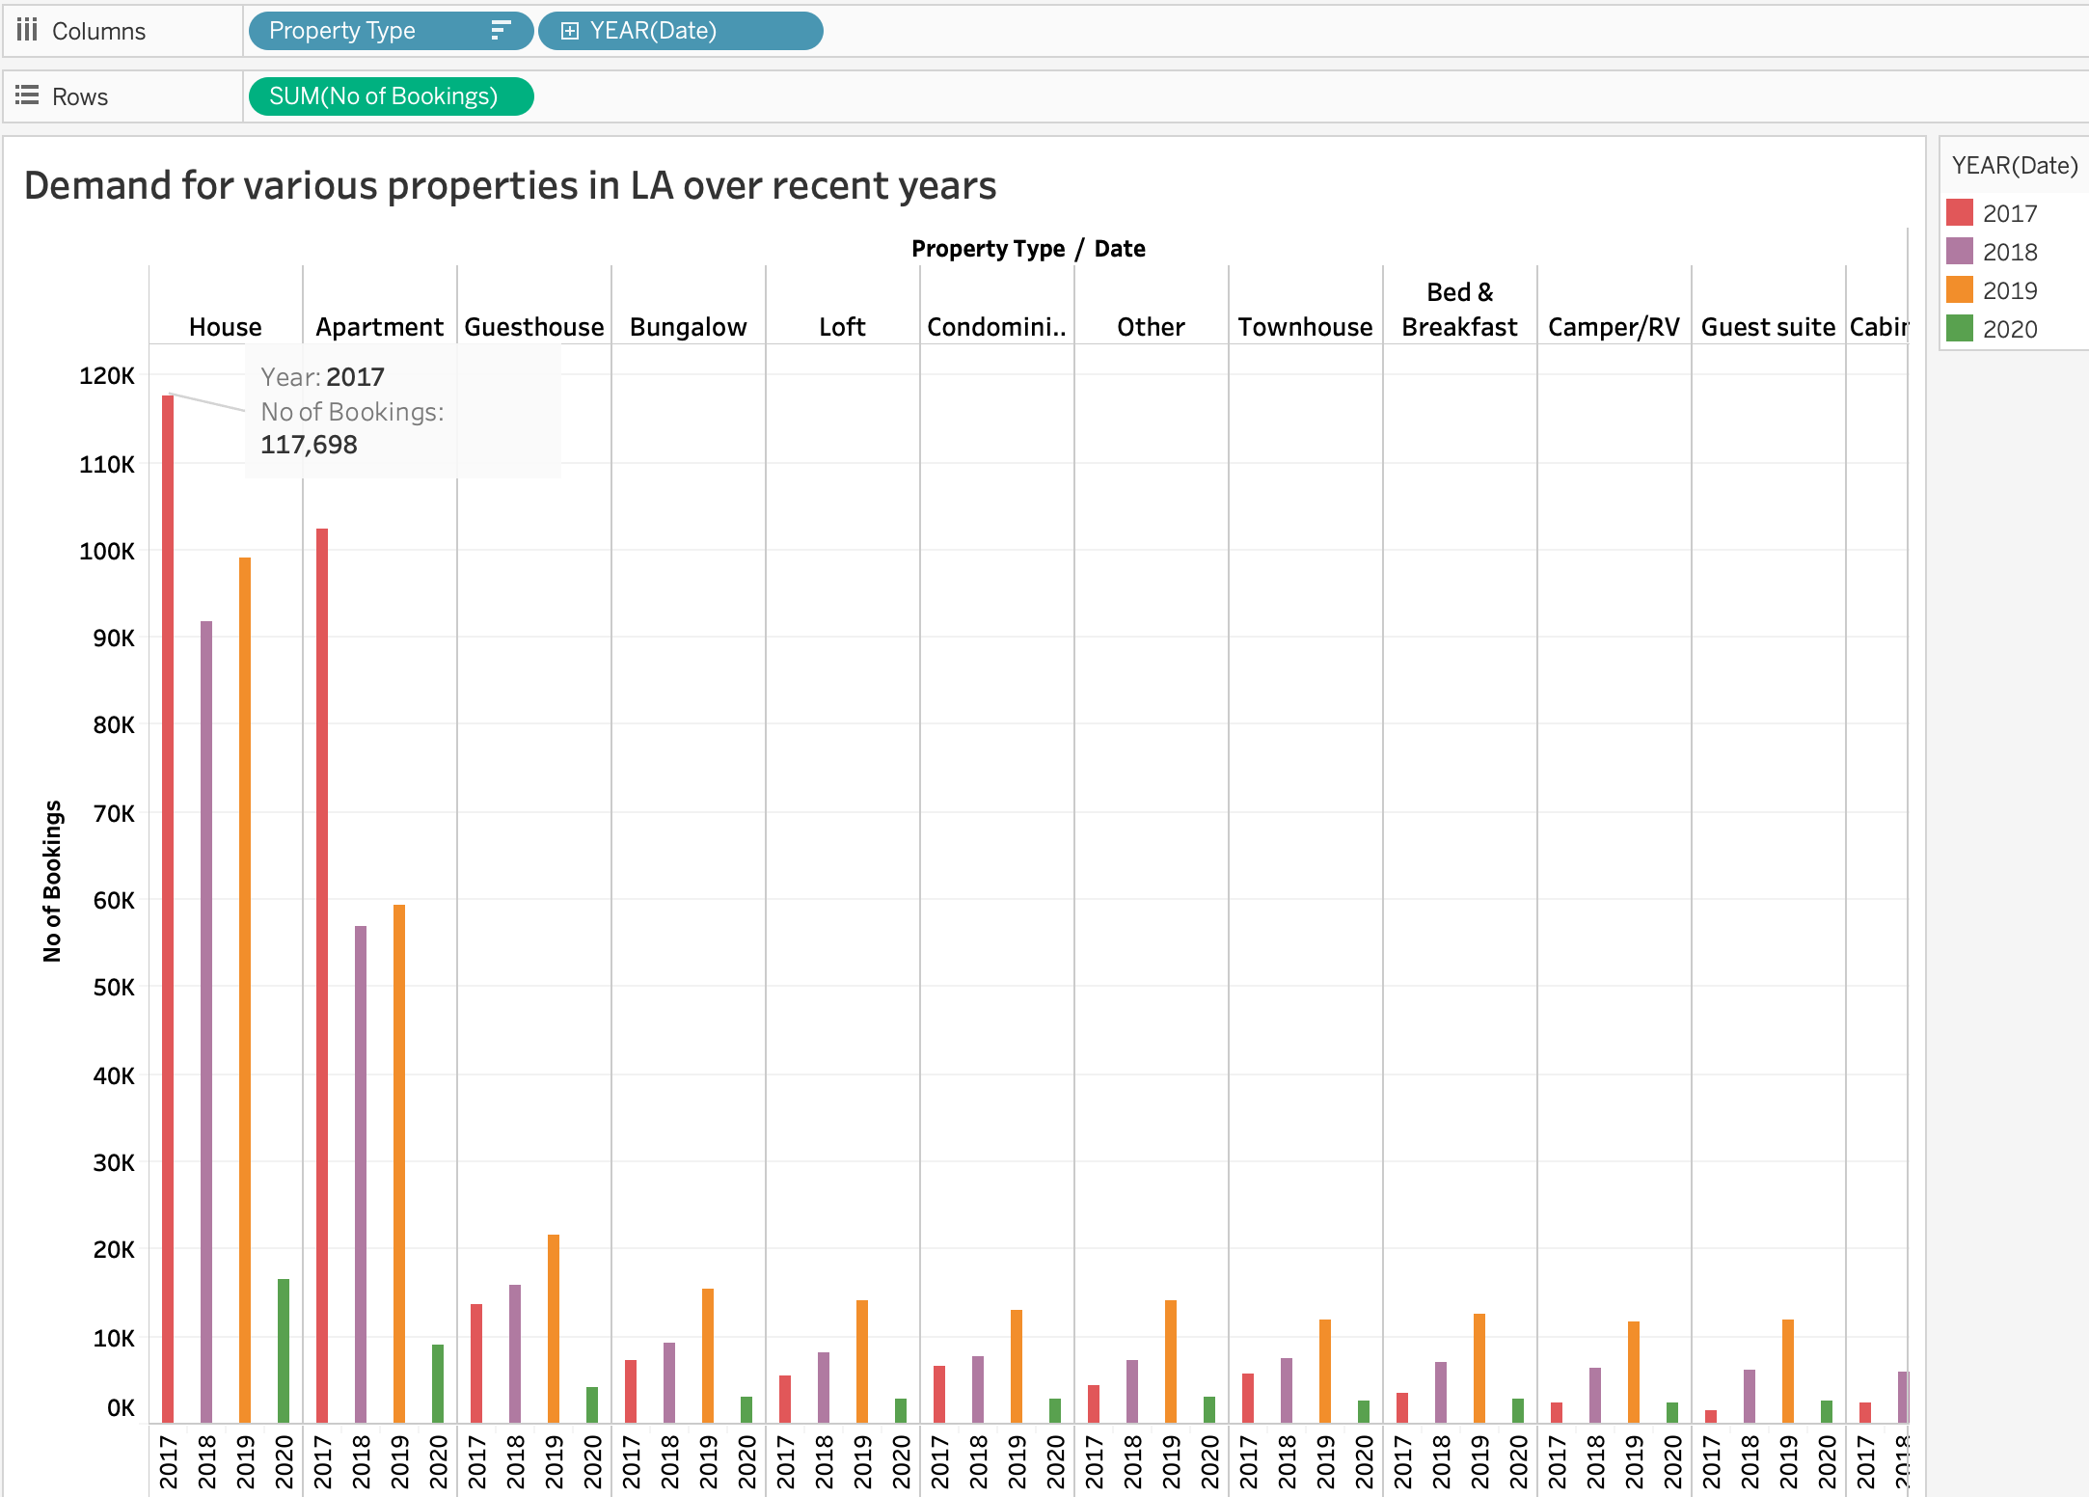
Demand For Various Property Types In LA
House type has the maximum number of bookings in LA in the year 2017

Slide 18
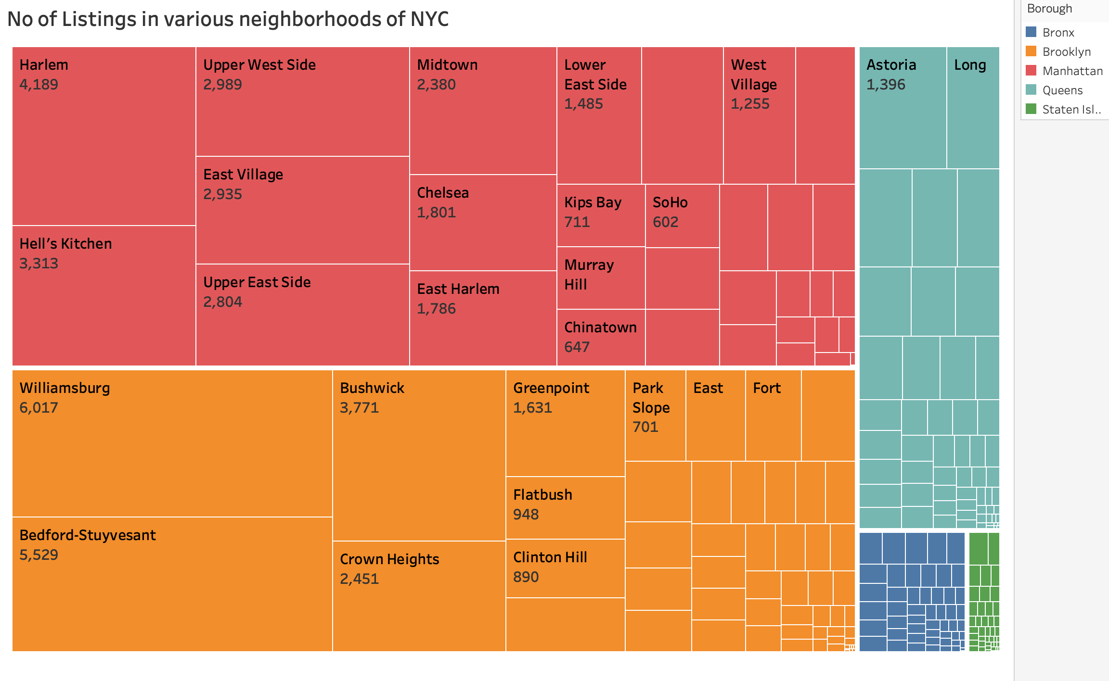
Listings In Various Neighborhoods Of NYC
Williamsburg of Brooklyn borough and Harlem of Manhattan borough have the highest number of listings

Slide 19
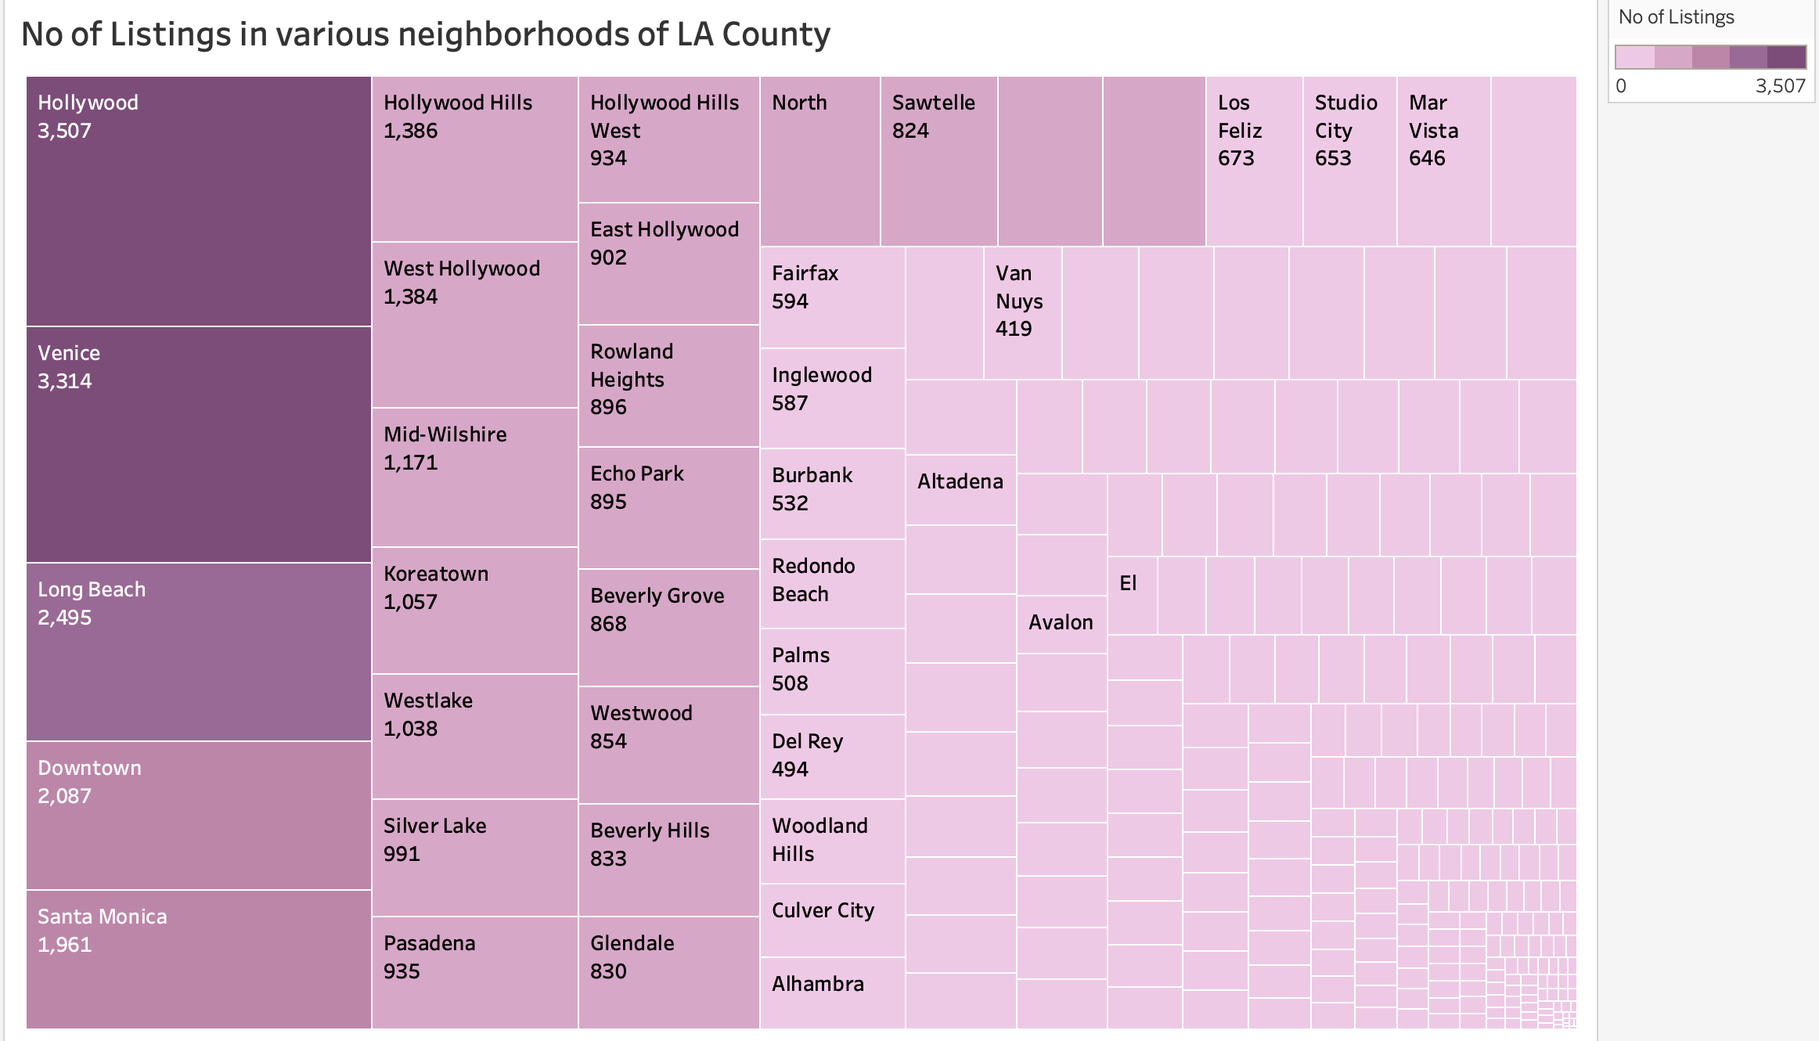
Listings In Various Neighborhoods Of LA
Hollywood and Venice are the neighborhoods with maximum number of listings

Slide 20
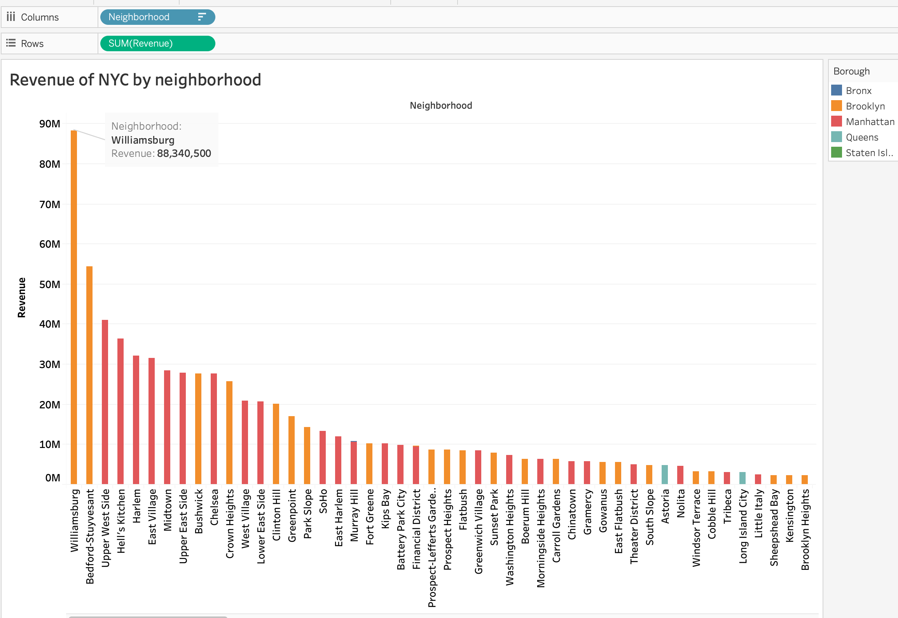
Revenue Of Various Neighborhoods Of NYC
Williamsburg of Brooklyn borough has the maximum revenue followed by Bedford-Stuyvesant.

Slide 21
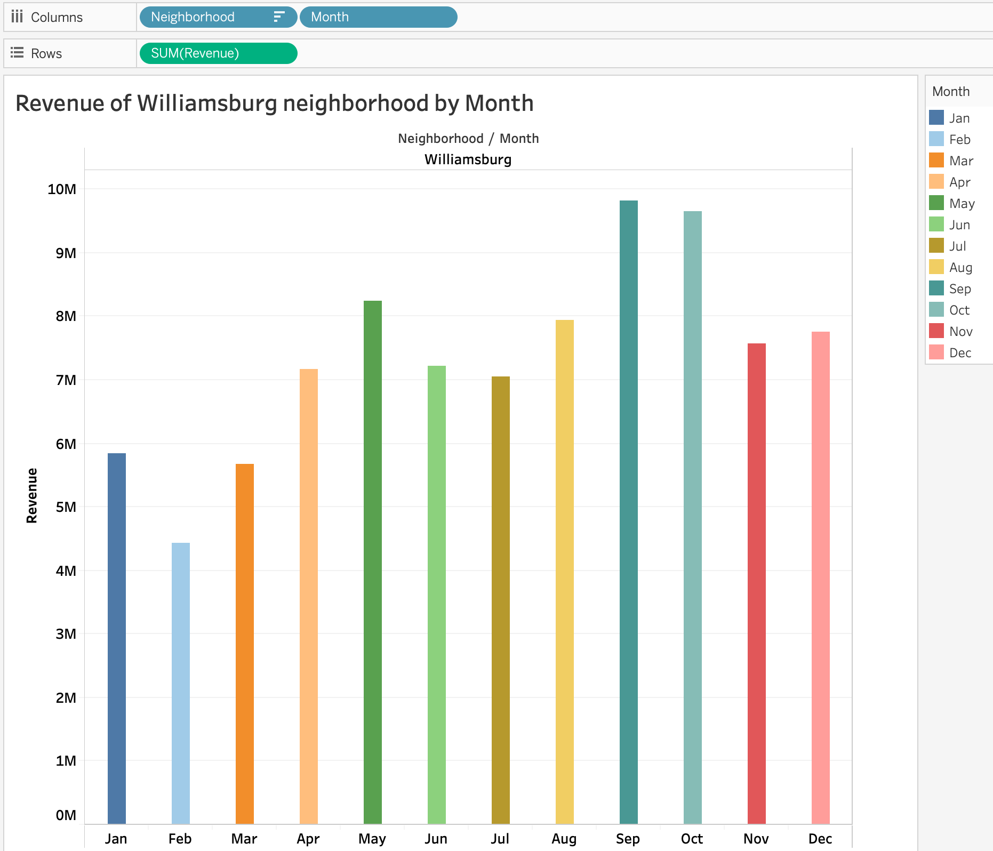
Revenue By Month
May, August, September and October are the months with maximum revenue
Animation Link:
https://drive.google.com/open?id=13Dogb1SeK4XVZtBz-7bWtEIoP1qKm08Y

Slide 22
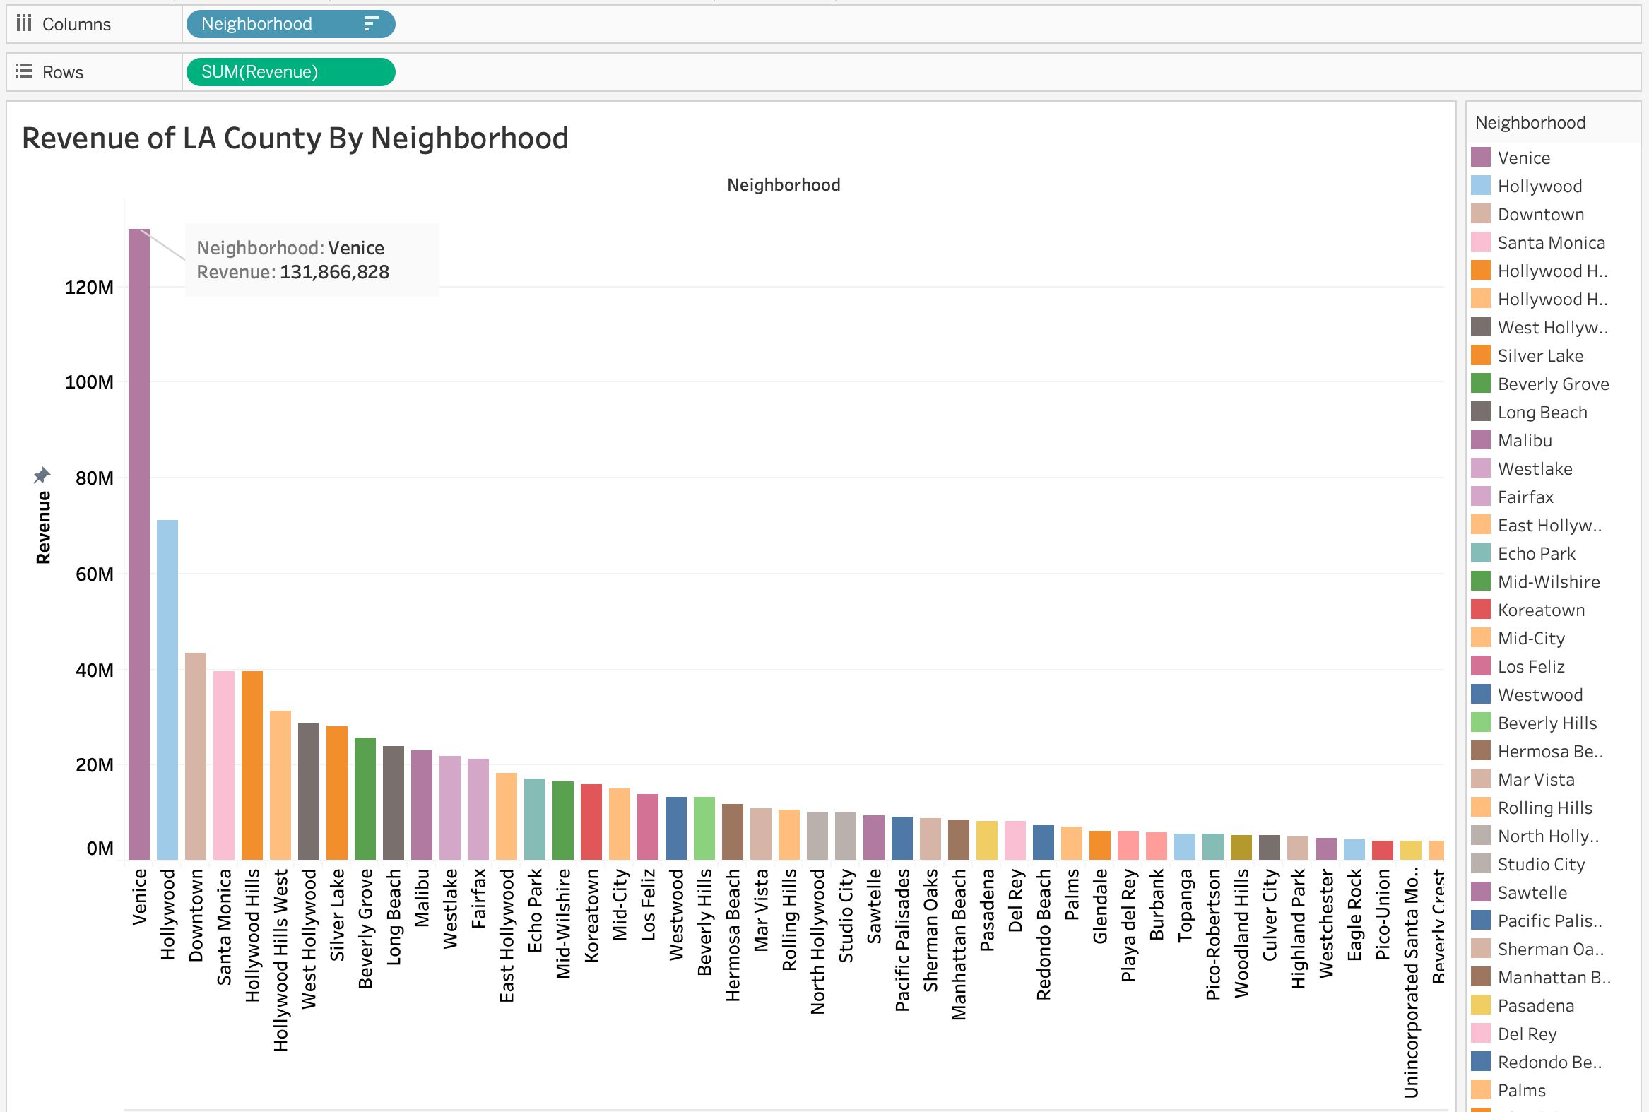
Revenue Of Various Neighborhoods Of LA
Venice has maximum revenue followed by Hollywood

Slide 23
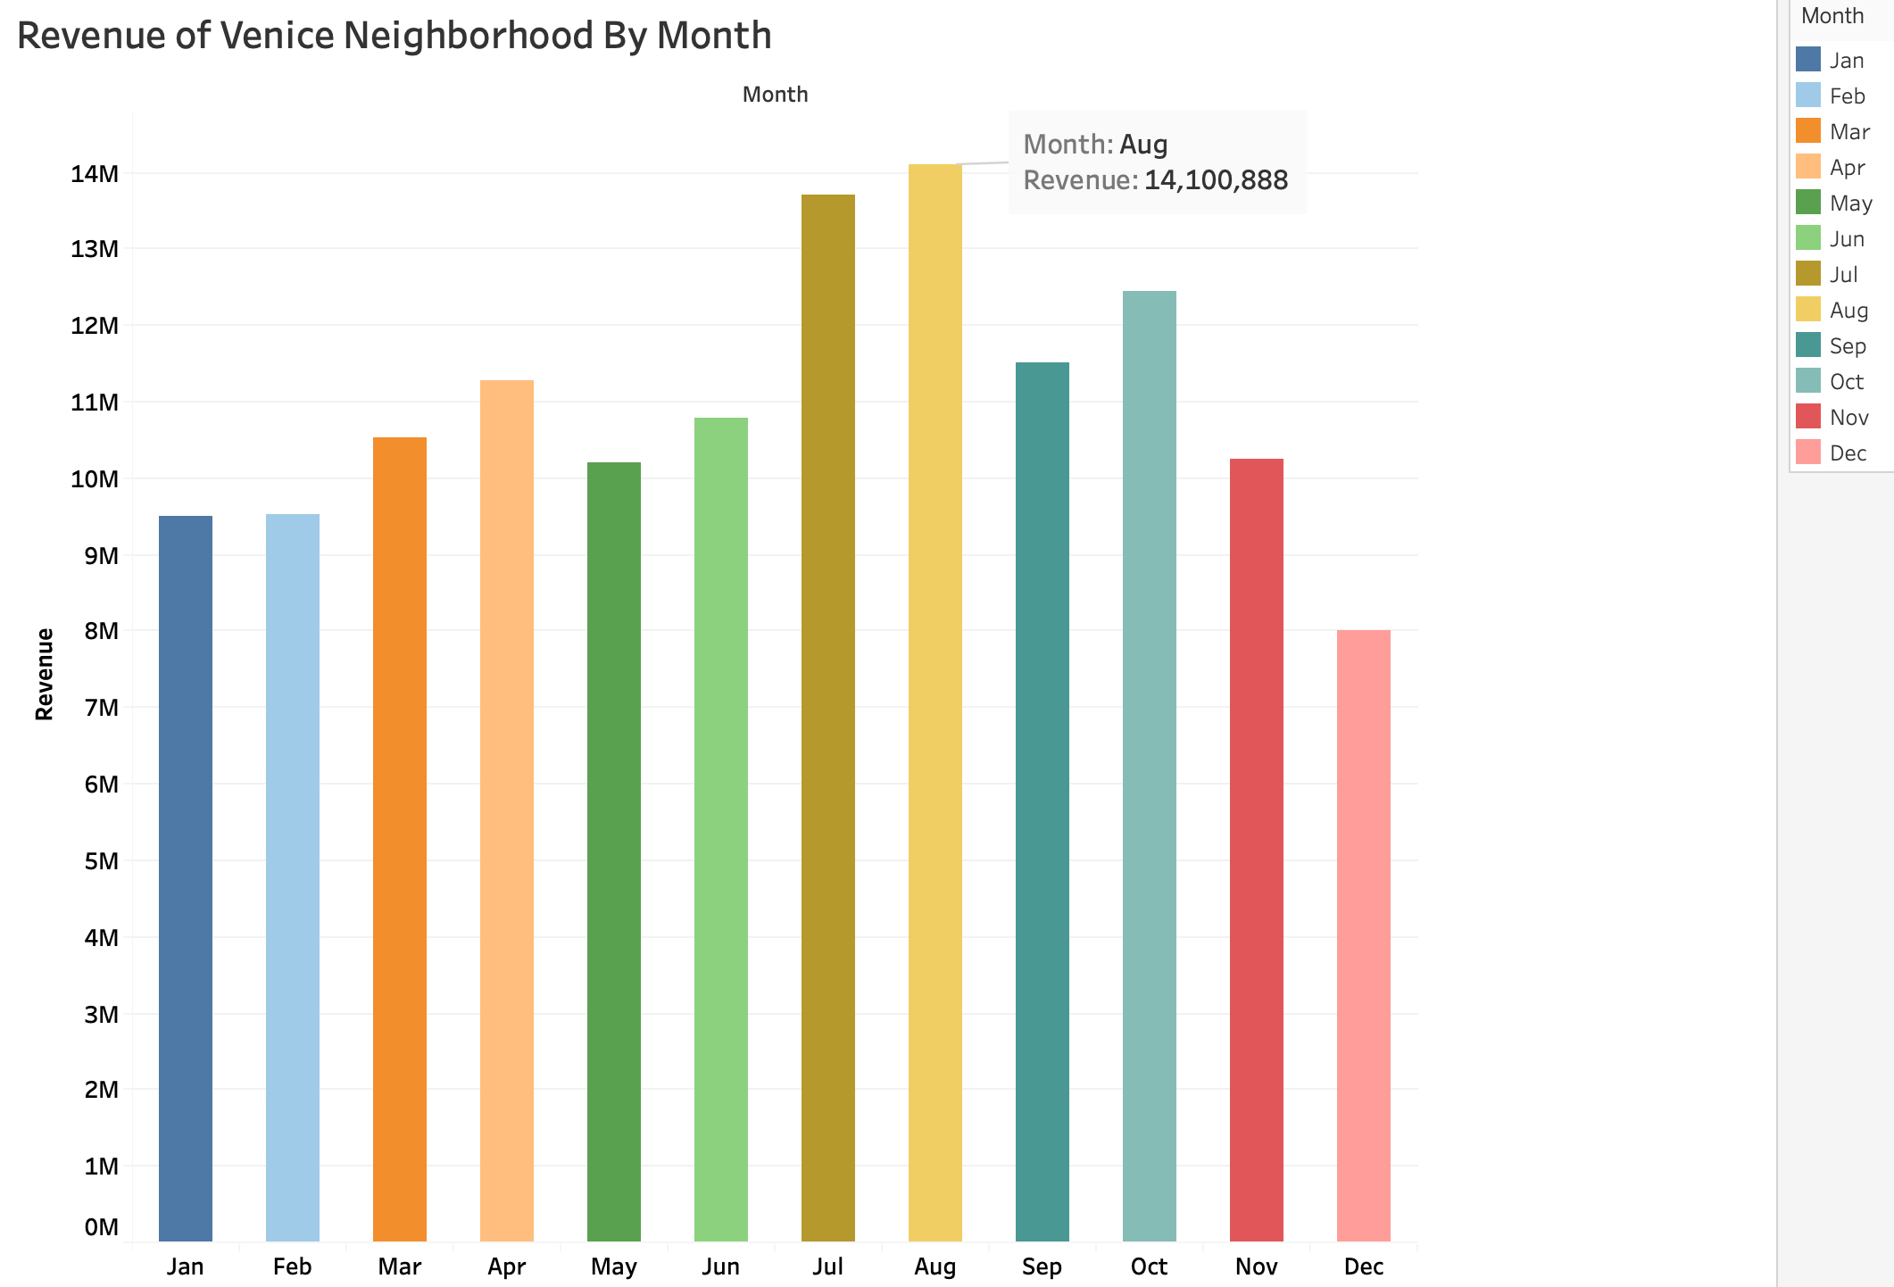
Revenue By Month
July and August months have seen the maximum revenue
Animation Link:
https://drive.google.com/open?id=1nFKsV9WFvQtb0NUvAnPTYnthLmXaMco0

Slide 24
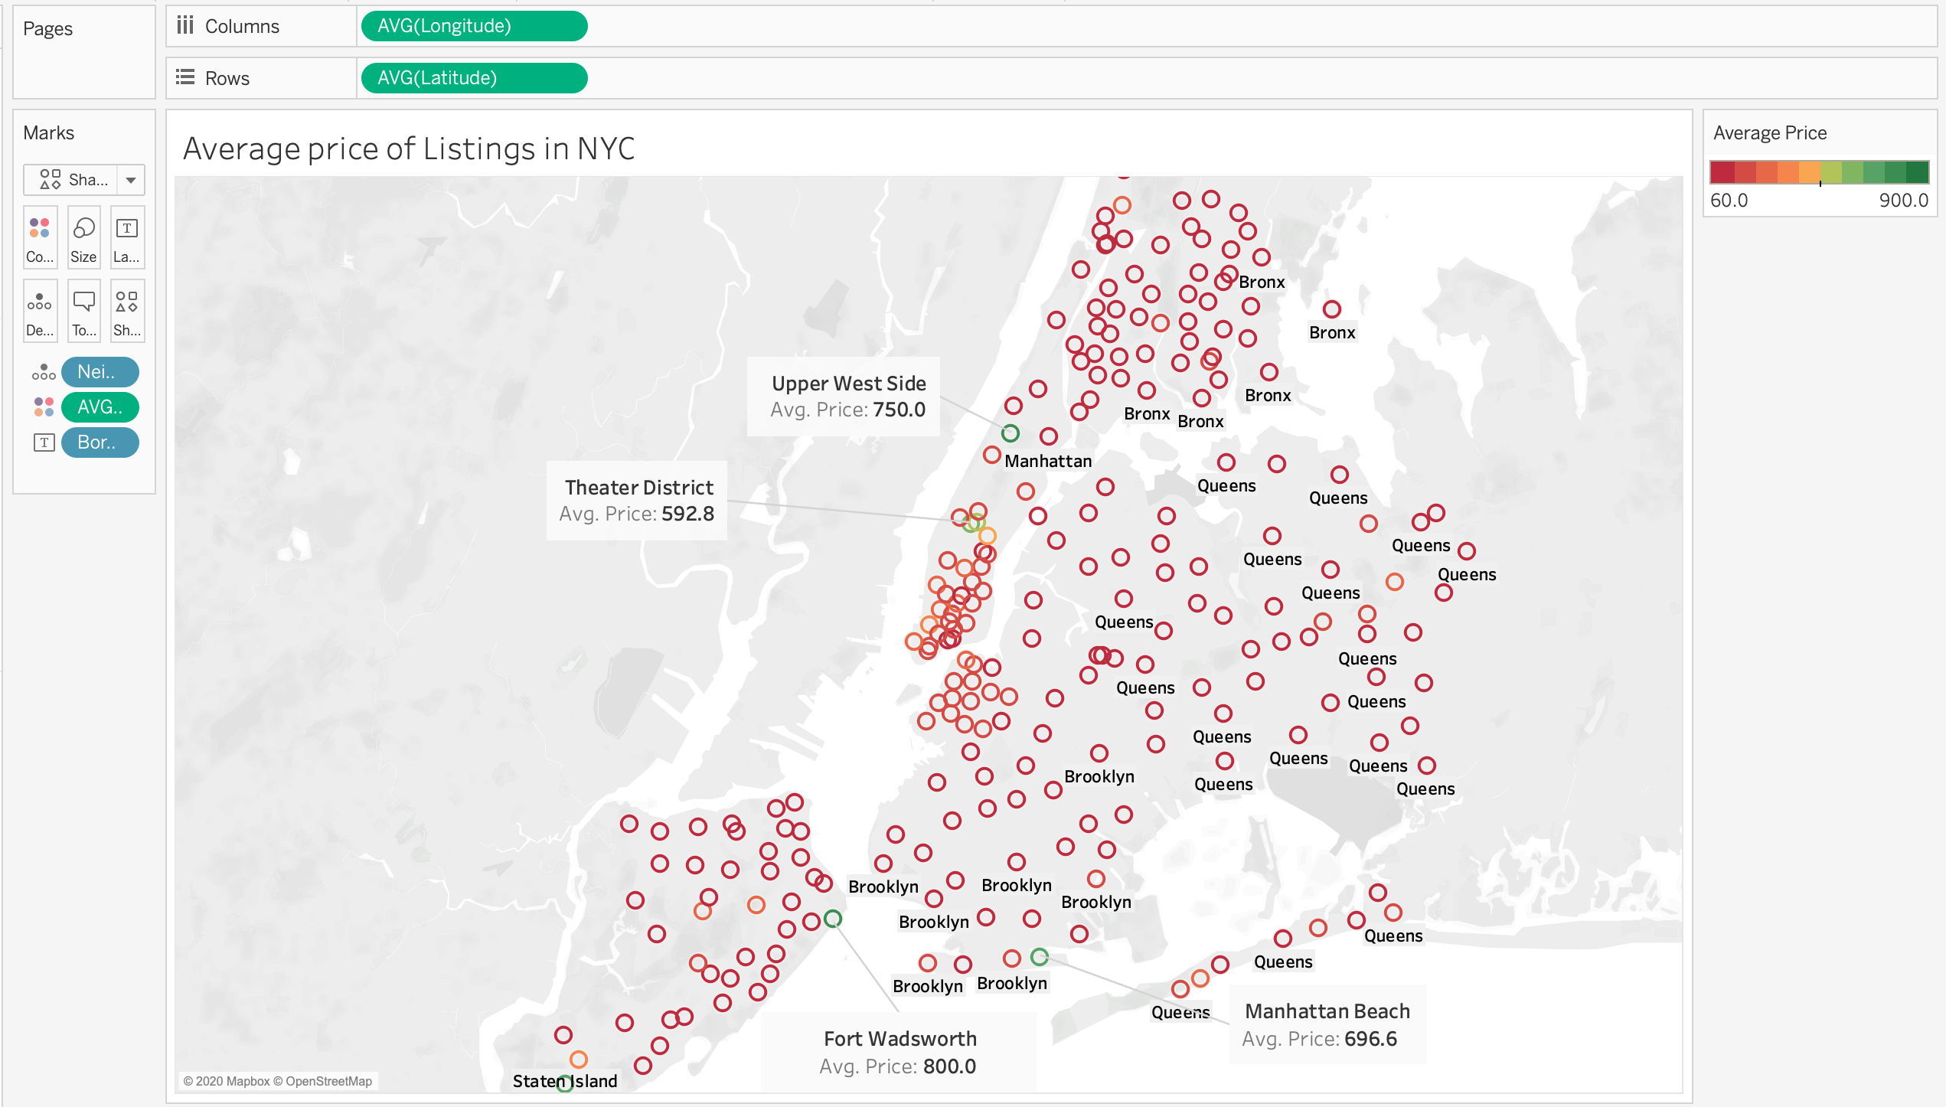
Average Price In NYC
Most expensive areas are Upper West Side, Manhattan Beach and Fort Wadsworth

Slide 25
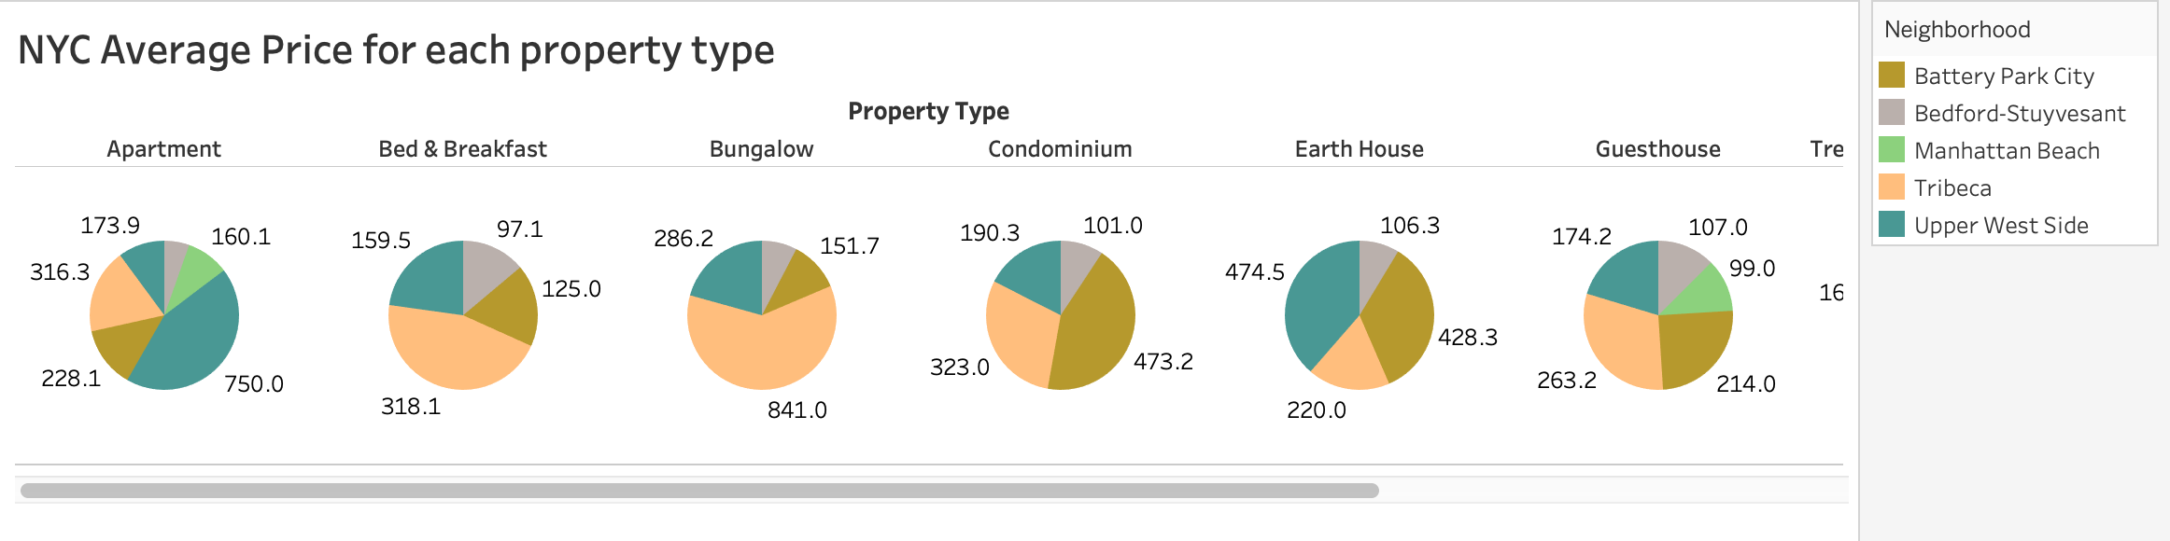
Average price of each property type in NYC
Average price for Apartment-Highest in Upper West Side
Average price for Bungalow- Highest in Tribeca

Slide 26
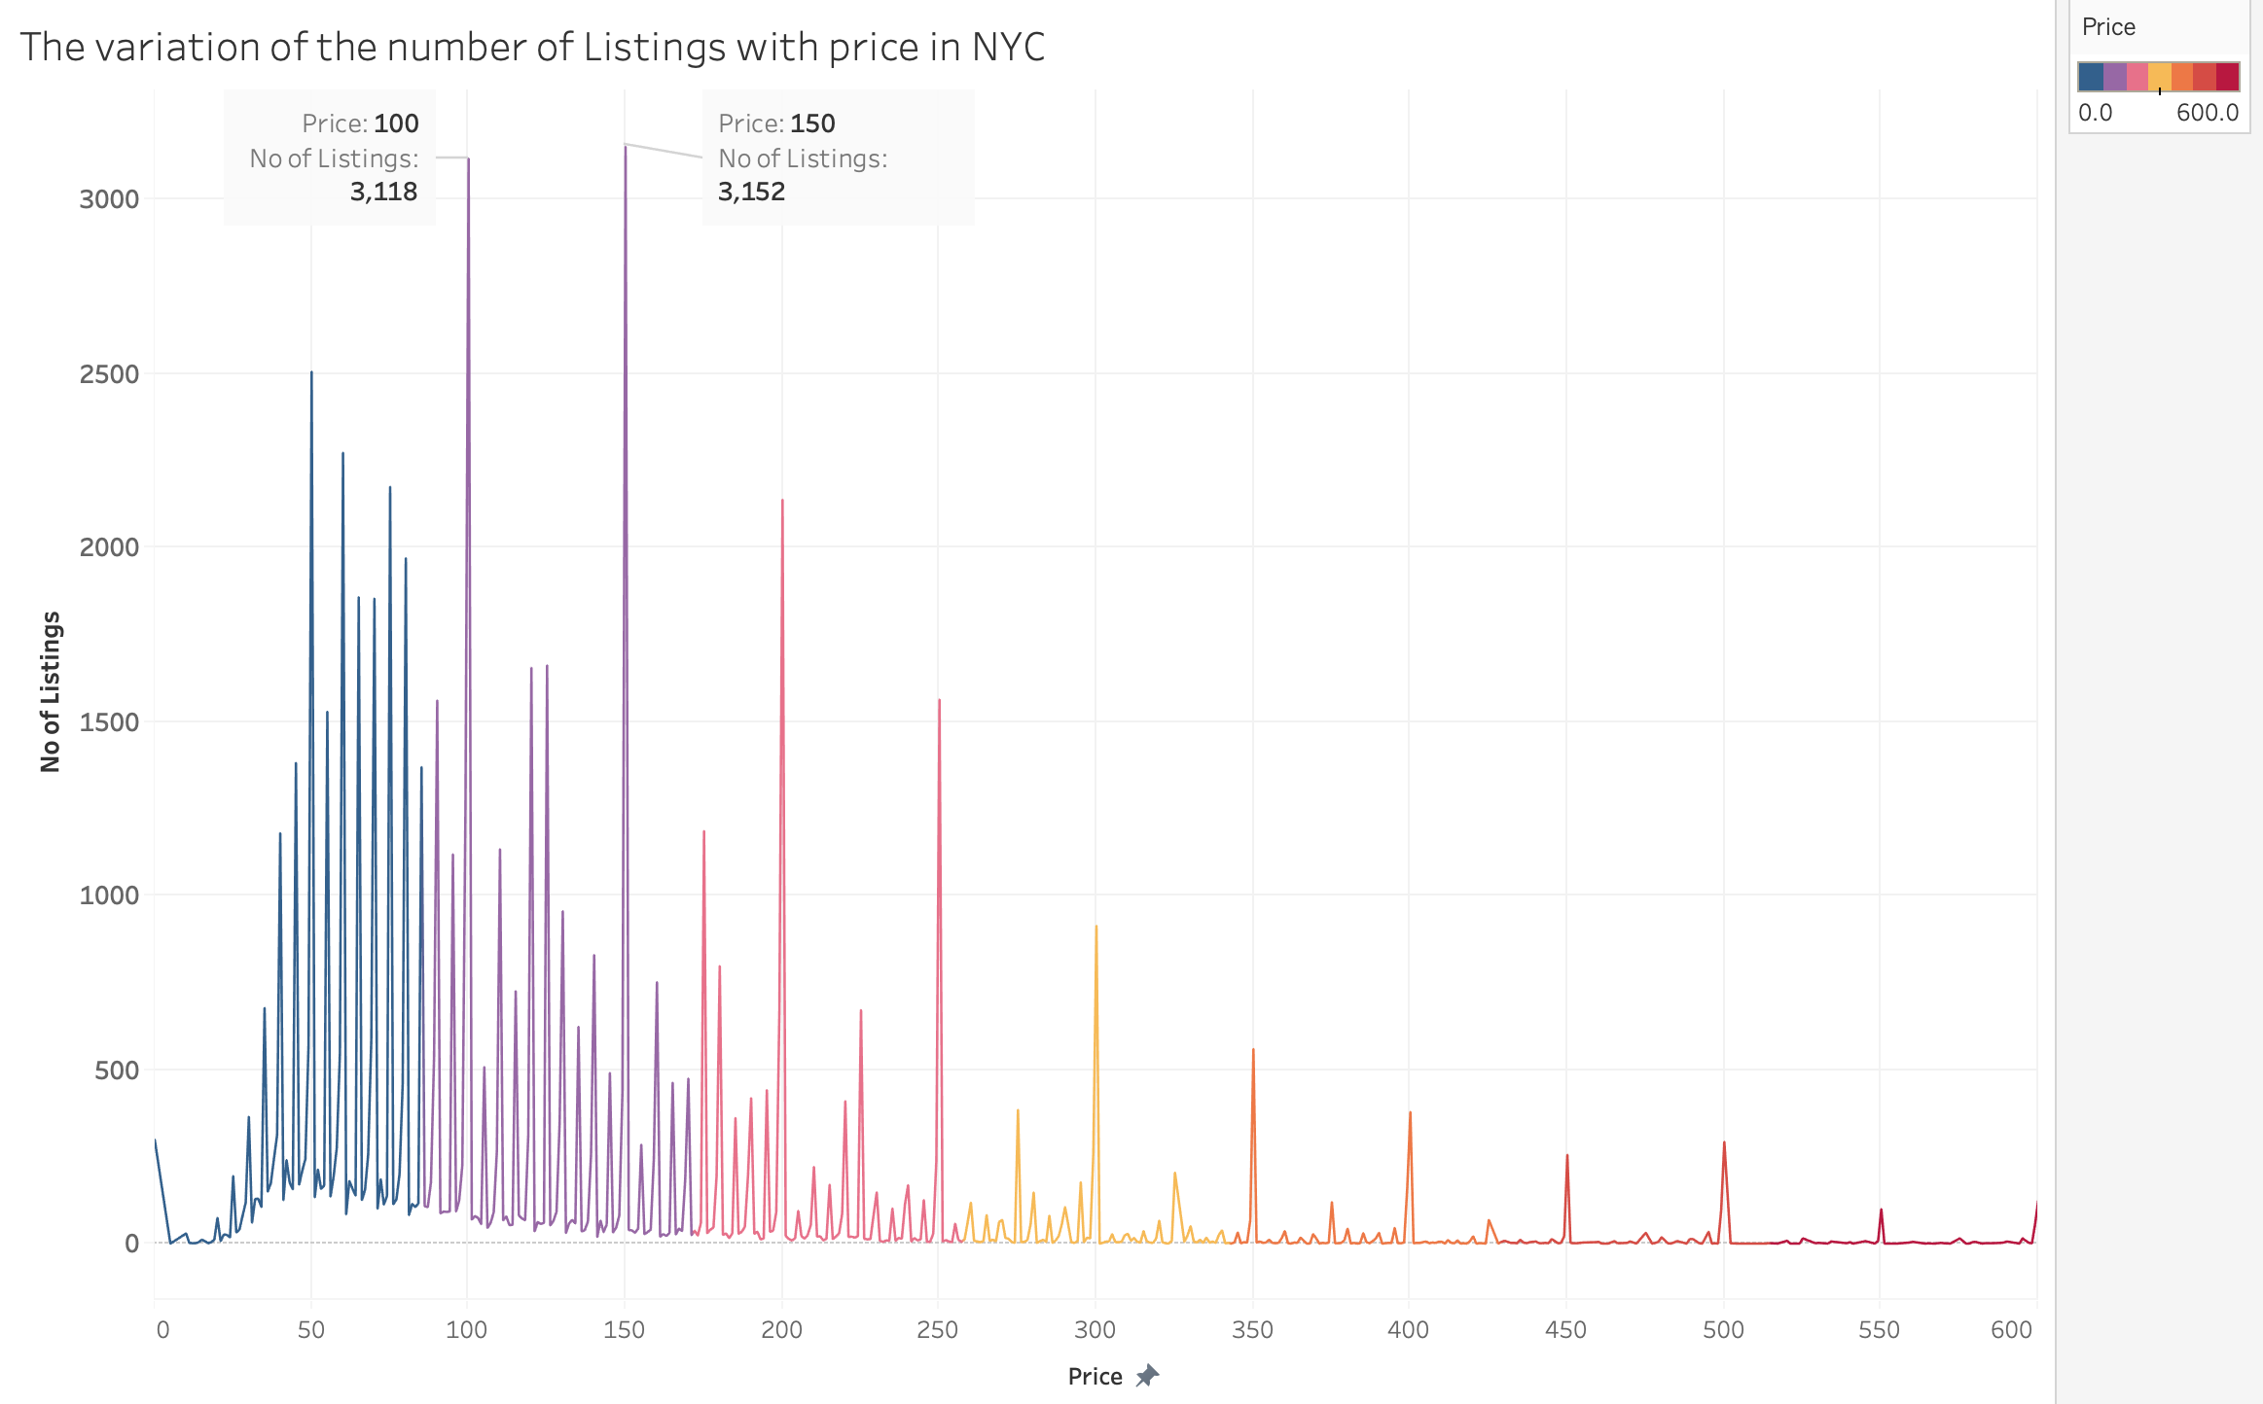
Number Of Listings For Each Price In NYC
The maximum number of Listings are within the price range of $50 and $150

Slide 27
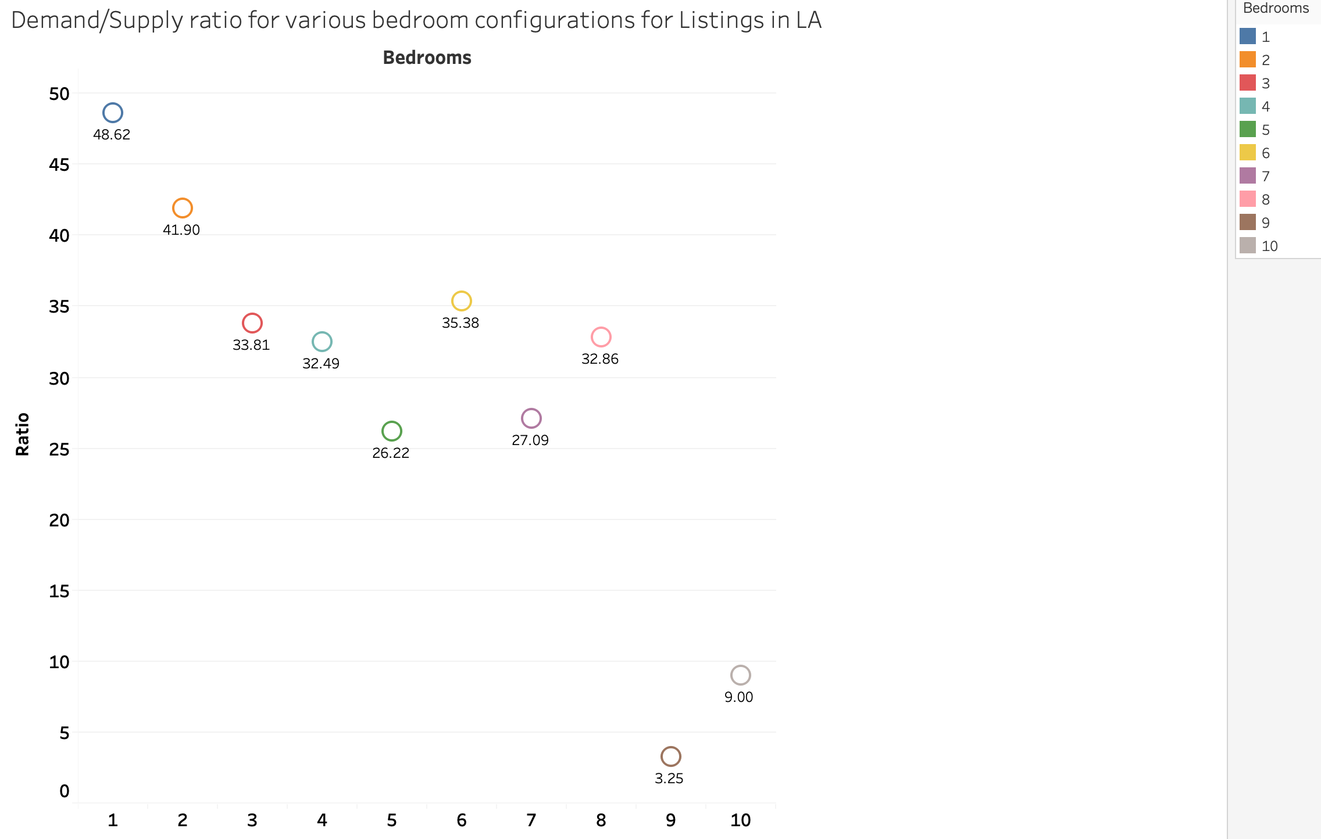
Demand-supply For Various Bedroom Configurations In LA
Properties with One and Two bedrooms are well sought after in LA

Slide 28
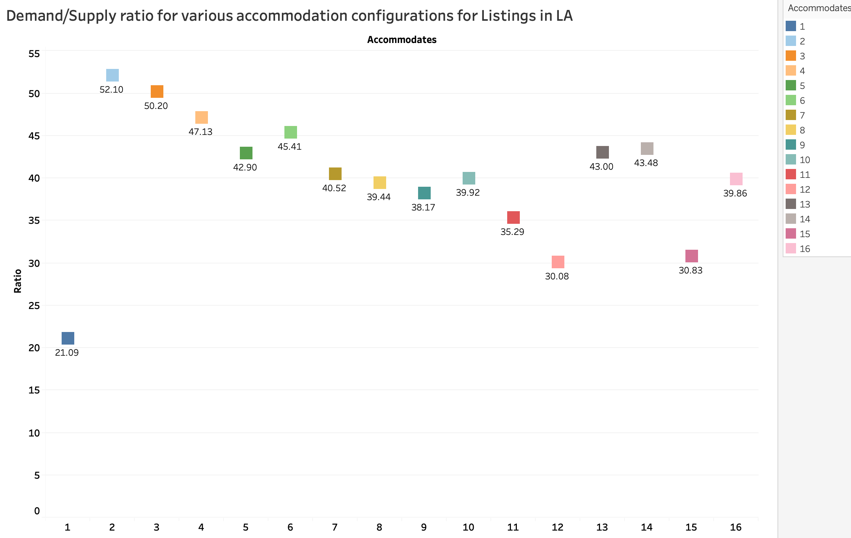
Demand-supply Accommodation In LA
The maximum demand is for properties that accommodates 2-3 people

Slide 29
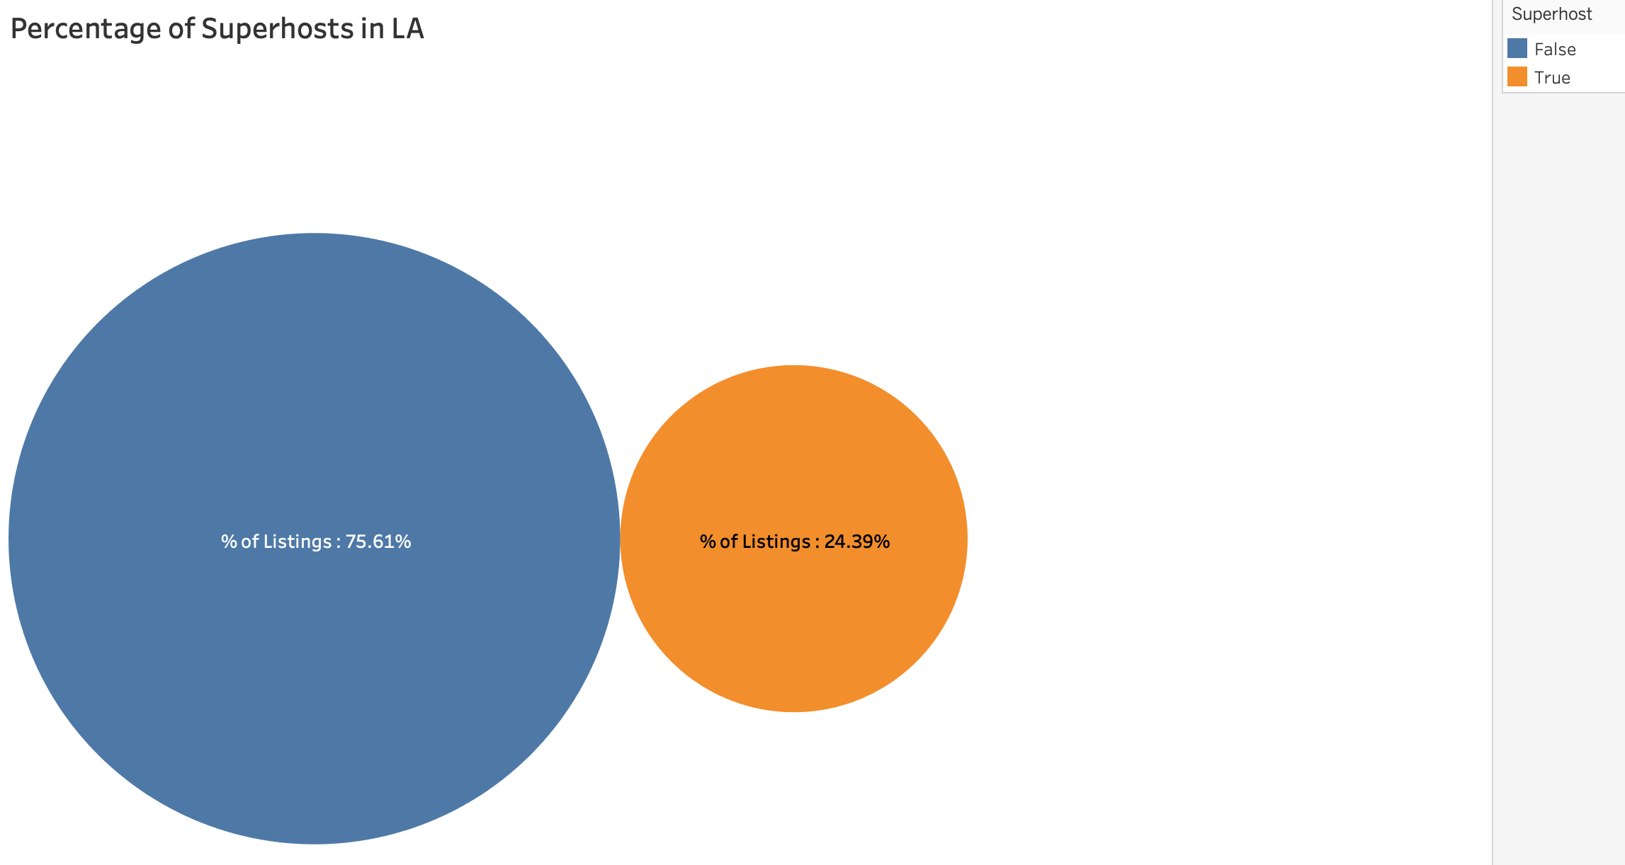
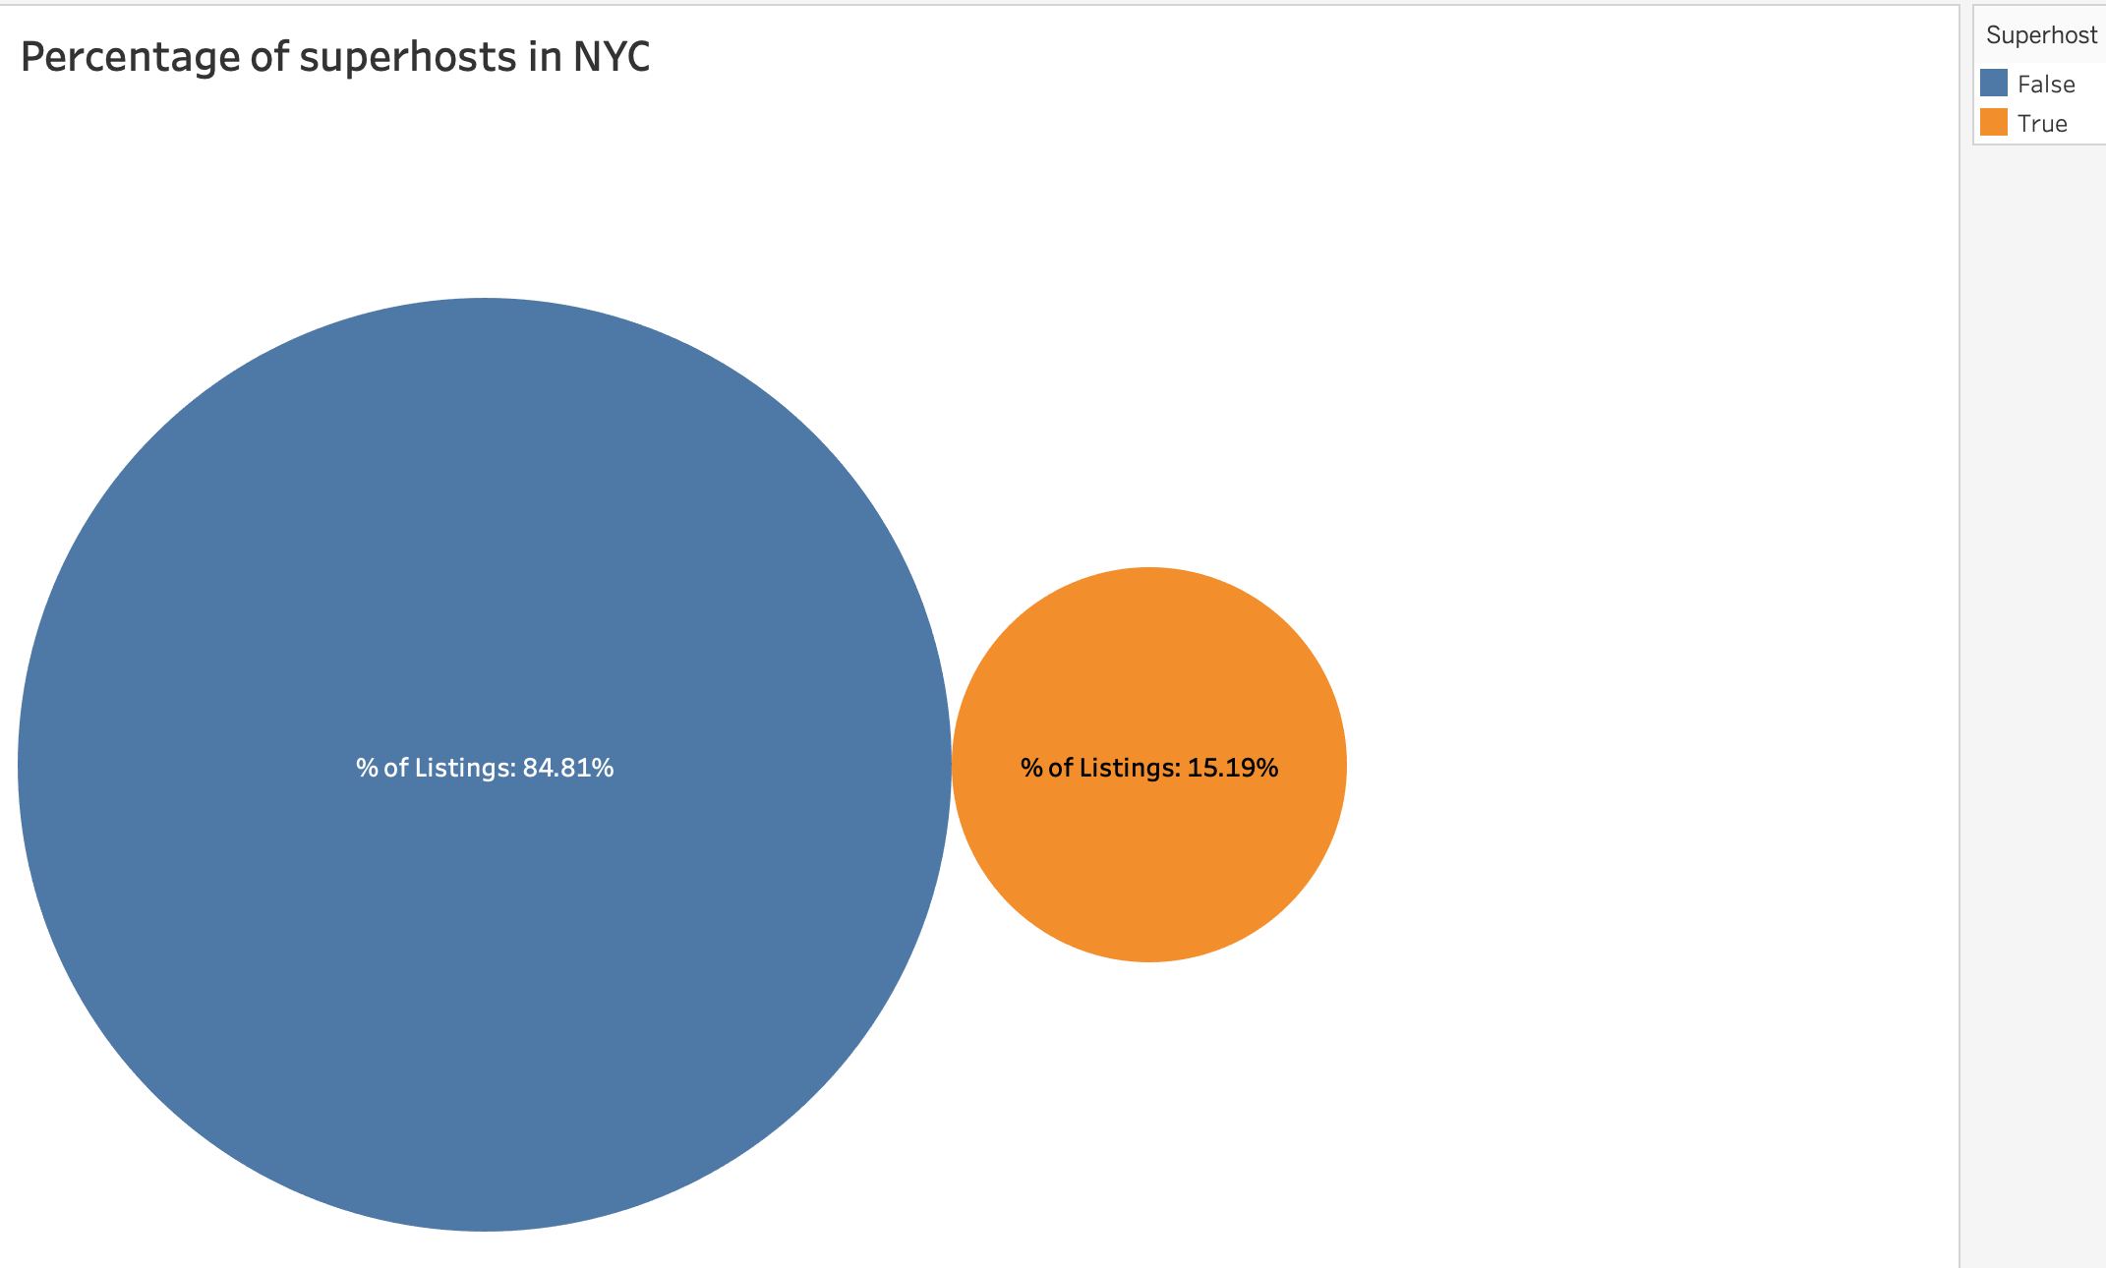
Percentage Of Superhosts In LA And NYC

Slide 30
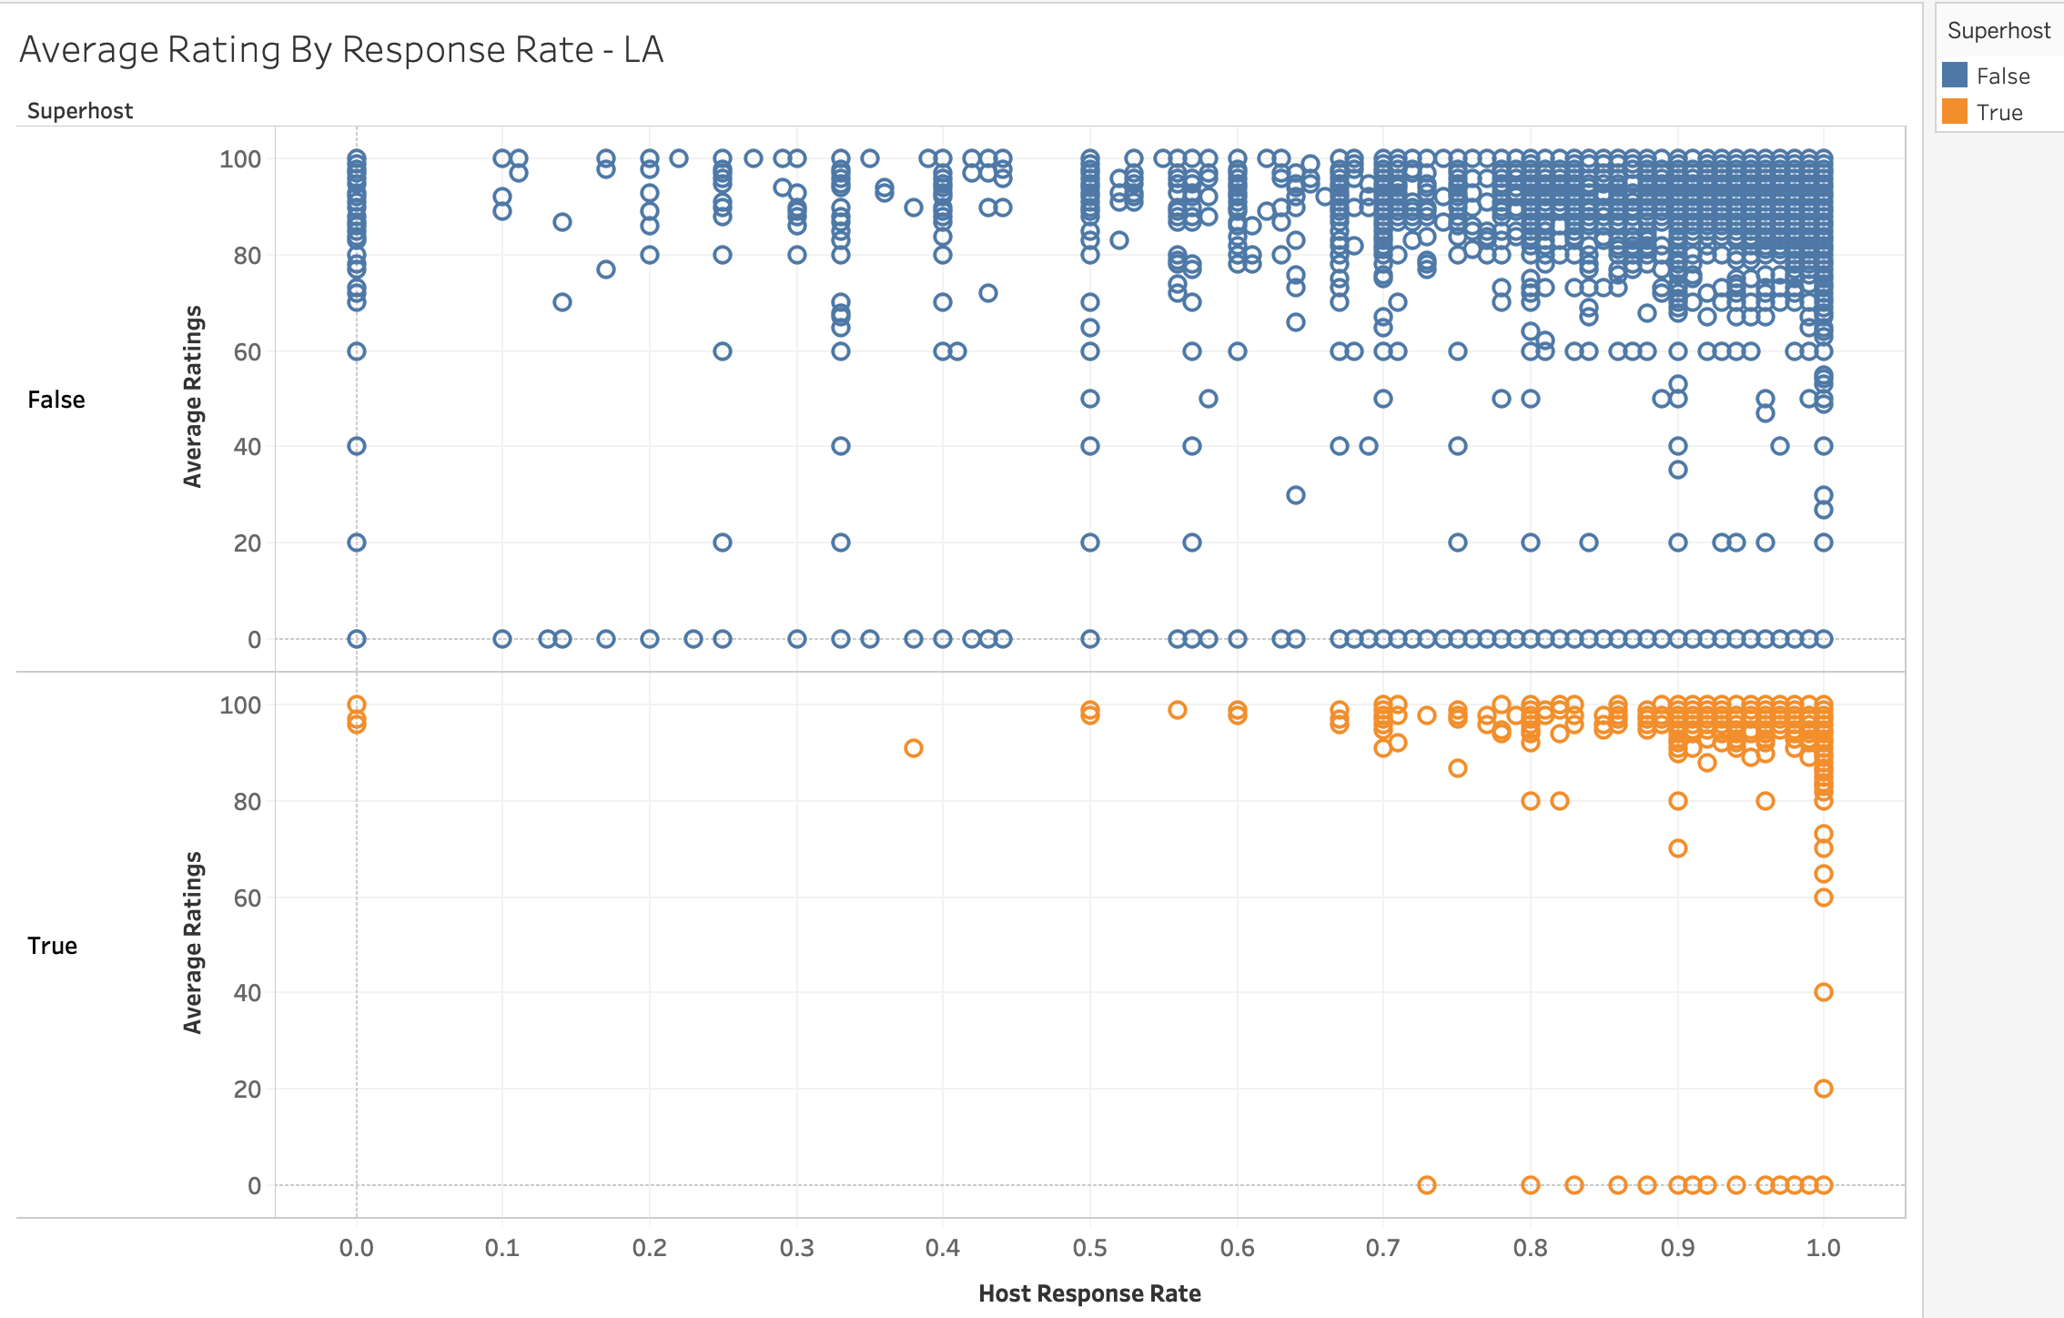
Rating By Host Response Rate
Becoming a Super host takes more than high ratings and high response rate

Slide 31

GITHUB URL
https://github.com/Samyuktha-M/5200-project

Slide 32



